Slide 1
Welcome to the AASHTO & TZD Subcommittee Webinar
October 27, 2020
Moderators
TZD Subcommittee Chair: Michelle May, Manager, Highway Safety Program, Ohio Department of Transportation
Vice Chair:
Kerry Wilcoxon, State Traffic Safety Engineer, Arizona Department of Transportation
Achieving Vision Zero
Anders Hartmann, Oslo, Norway, Senior Adviser, Asplan Viak
Tools and Techniques for Keeping Vulnerable Road Users Safe
Michelle Atwell, Chief, NHTSA Safety Countermeasures Division
Mike Griffith, Director, Office of Safety Technologies, Federal Highway Administration
Targeting High-Risk Pedestrian Corridors
Jeremy Thompson, Safety Engineer, Ohio Department of Transportation

Slide 2
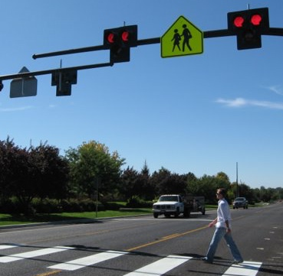
TZD Subcommittee presents:
“Spotlight on Safety” Webinar
Notes:
Welcome everyone to our first TZD Subcommittee “Spotlight on Safety” Webinar.
Today’s topic is on Vulnerable Road Users.
“As the number of pedestrians and cyclists killed or injured across the country continues to grow, more Americans are calling for increased attention and investments in safe infrastructure for vulnerable
users. We’ve assembled a group of speakers who will explore international, city, state and federal perspectives on how to achieve greater safety and equity for these road users.”

Slide 3
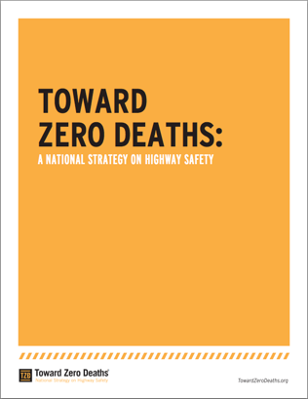
TZD Subcommittee
Lead zero-based initiatives
Support state SHSP efforts
Build new partnerships
Communicate safety issues and initiatives
Promote multidisciplinary approaches to eliminating traffic fatalities and serious injuries
Notes:
This webinar is brought to you by the AASHTO TZD Subcommittee – whose role is to

Slide 4
Forum for Safety Champions
Build a TZD community of practice
  On-line meetings
  Sharing best practices
  Collaborate with one another by sharing our collective experience
Chair: Michelle May, Ohio DOT
Vice Chair: Kerry Wilcoxon, Arizona DOT
Notes:
My name is Michelle …
My vice chair is Kerry …
It’s our ultimate goal to build …

Slide 5
Webinar: Vulnerable Road Users
Achieving Vision Zero
Anders Hartmann, Asplan Viak (Oslo, Norway)
Tools and Techniques for Keeping Vulnerable Road Users Safe
Michelle Atwell, NHTSA
Mike Griffith, FHWA
Targeting High-Risk Pedestrian Corridors
Jeremy Thompson, Safety Engineer, Ohio Department of Transportation
Notes:
We have three parts to this webinar.
For both a city and international perspective, we have Anders Hartmann
For a federal perspective – we have
For a state perspective, we have my colleague Jeremy …
Housekeeping note:
Unless there are burning questions – we will likely take questions at the end.
Please post your questions throughout the webinar so we can capture and answer them.
I will now introduce Anders as he takes control of the screen.

Slide 6
Achieving Vision Zero
AASHTO – Spotlight on safety

Slide 7
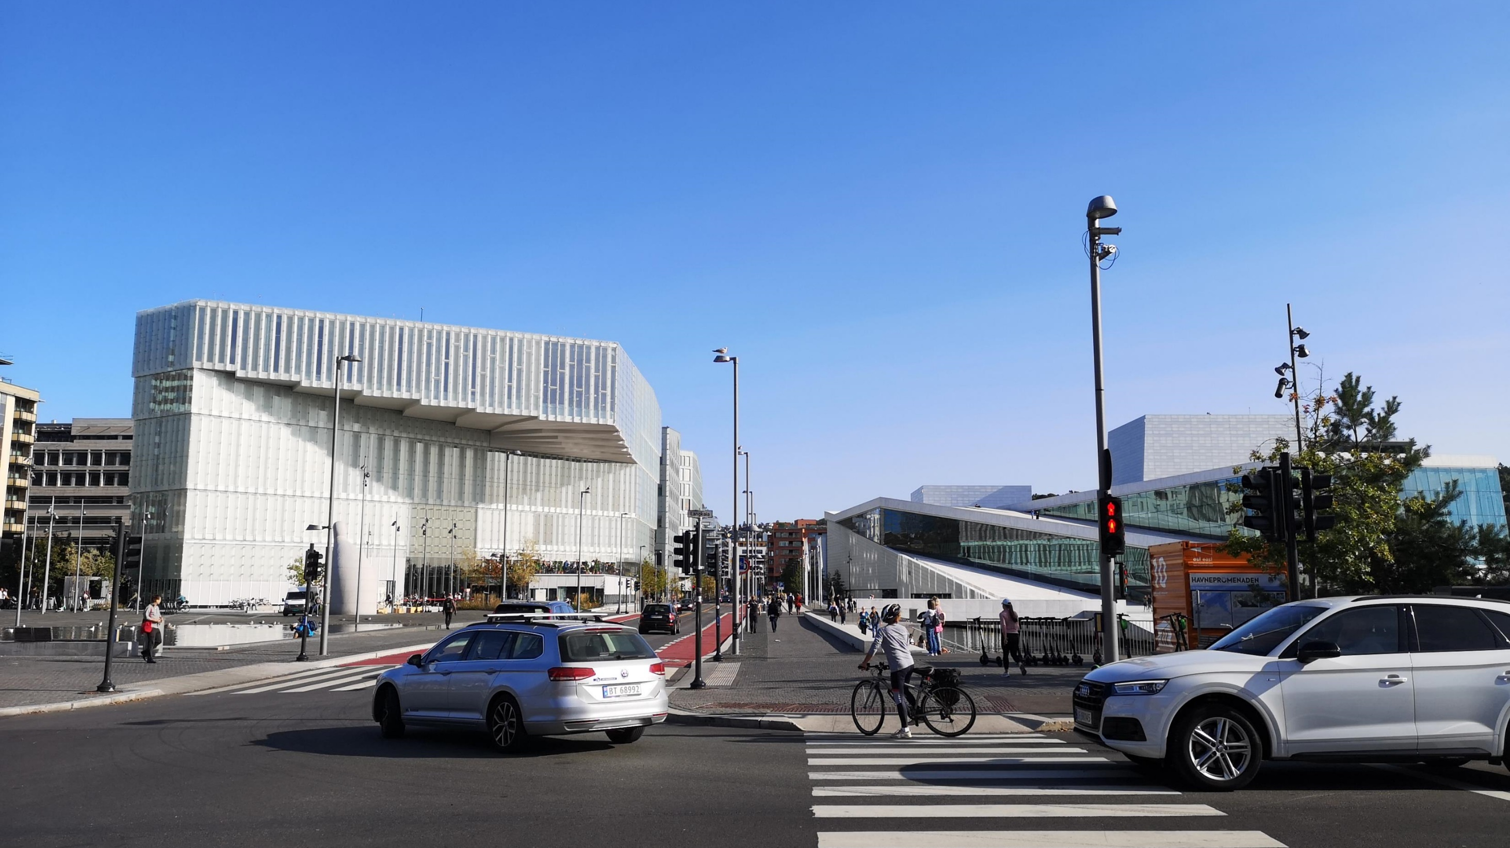
Notes:
New street in the centre of Oslo. Opera house and recently opened central library to the left. Red signature bike lanes.
This intersection was the site of the last cyclist fatality in Oslo, a little more than two years ago. It has since been rebuilt.

Slide 8
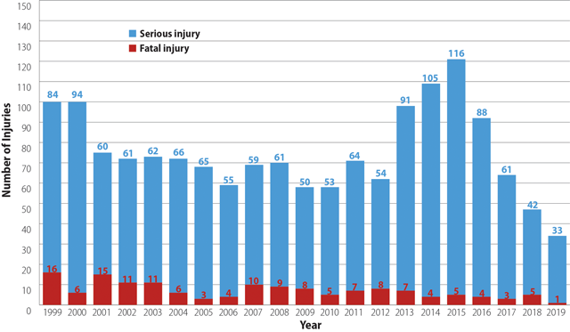
2019 traffic fatalities in Oslo
0 children
0 pedestrians
0 cyclists
1 car driver
Road injuries in Oslo, 1999-2019. (Graph from ITE Journal)
Notes:
We don’t know exactly what have caused the changes since 2012.
But in this presentation, I’ll cover some of the measures that may have contributed.
For the time being, 2019 may have been an outlier.
So far this year, there have been four fatalities in Oslo. 3 motorcyclists, and one 2 year old child.
So, we’re not at zero yet.

Slide 9
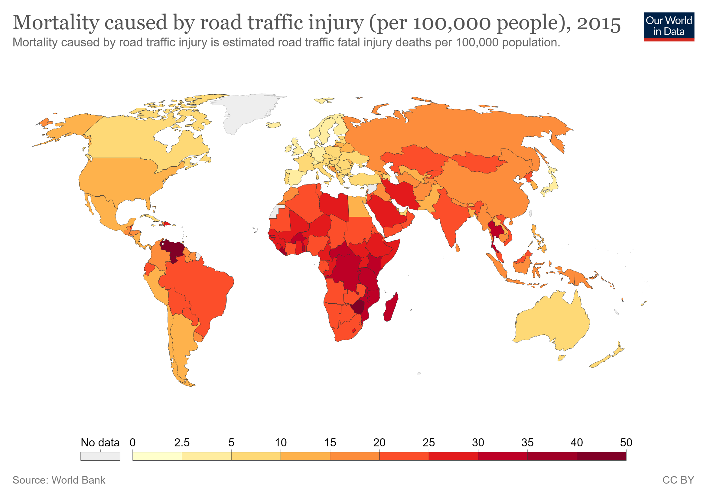
Oslo
Notes:
Oslo benefits from being the largest city in the safest country in the world.
Regarding road safety, Norway has had the lowest mortality rate five years in a row.
Down to 2.7 road deaths per 100,000 people in 2019.

Slide 10
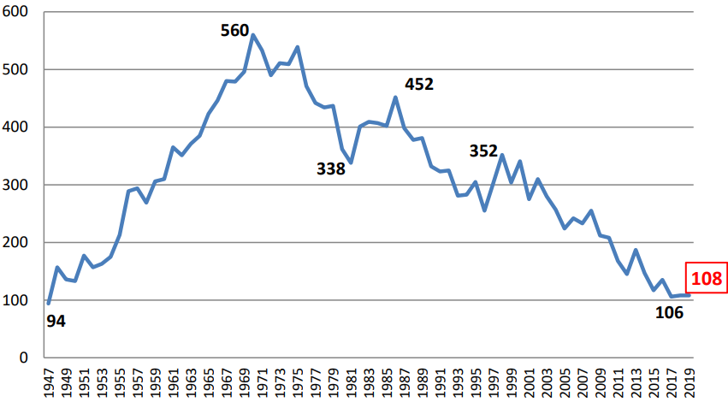
Road safety progress in Norway
Oslo benefits from national improvements in road safety.
Nationally, the main improvements come as a result of:
Safer vehicles
Slower speeds
Road deaths in Norway per year (National public roads admin.)
Notes:
Strict EU vehicle regulations
Cities can lower speed limts on municipal roads
Automatic speed enforcement on highways

Slide 11
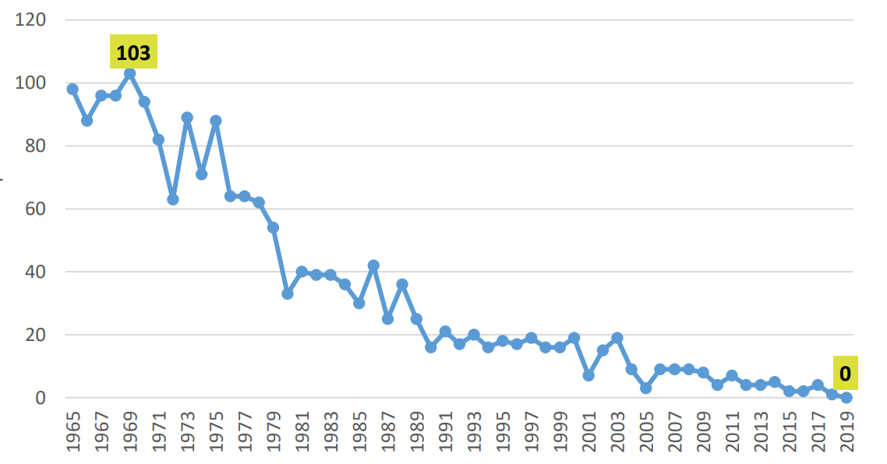
Norway reached Vision Zero for children in 2019
For the first time, no children died in traffic last year.
Not only in Oslo, but for all of Norway.
Oslo hasn’t had any fatalities in the 6-15 age group since 1999.
Road deaths in Norway per year for the 0-15 age group
(National public roads admin.)
Notes:
For decades, road safety policy in Norway has prioritized children.
Most communities have continuous safe routes to school programmes.

Slide 12
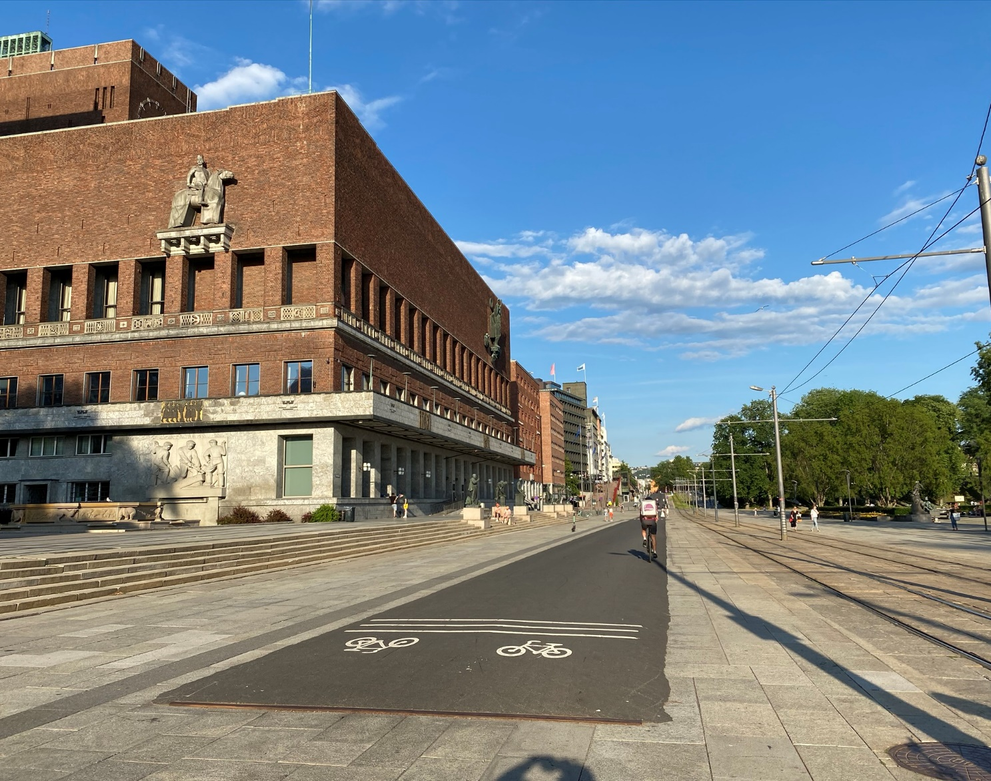
Oslo
697 000 inhabitants
800-mile street network
66 % of streets have 19 mph speed limit
67 % walk/bike/transit modal share
69 % battery electric vehicle market share*
Temporary bike lane in front of City Hall
*September 2020, excluding hybrids
Notes:
6 % bike modal share
Covid: 40 % increase in cycling

Slide 13

Important policy changes in 2015
New city government:
  Ban on road widening (for cars)
  Pledge to build 9 miles of bike lanes a year
  Pledge to reduce traffic (VMT) by 30 % by 2030.
  Increased road tolls
  Car free city center
The city council adopted an ambitious cycling strategy. Goal of 16 % modal share for cycling.
The city was granted wide authority over traffic control devices (bike lanes, bus lanes, street closures etc.)
Lan Marie Nguyen Berg, Vice Mayor for Environment and Transport
Photo: Sturlason
Notes:
Together with the cycling strategy, a bike network plan lays out a billion dollar cycling network to be established over the next 15 to 20 years.
The city government was reelected last year. They have pledged to
introduce 20 mph as a standard citywide speed limit
remove parking minimums

Slide 14
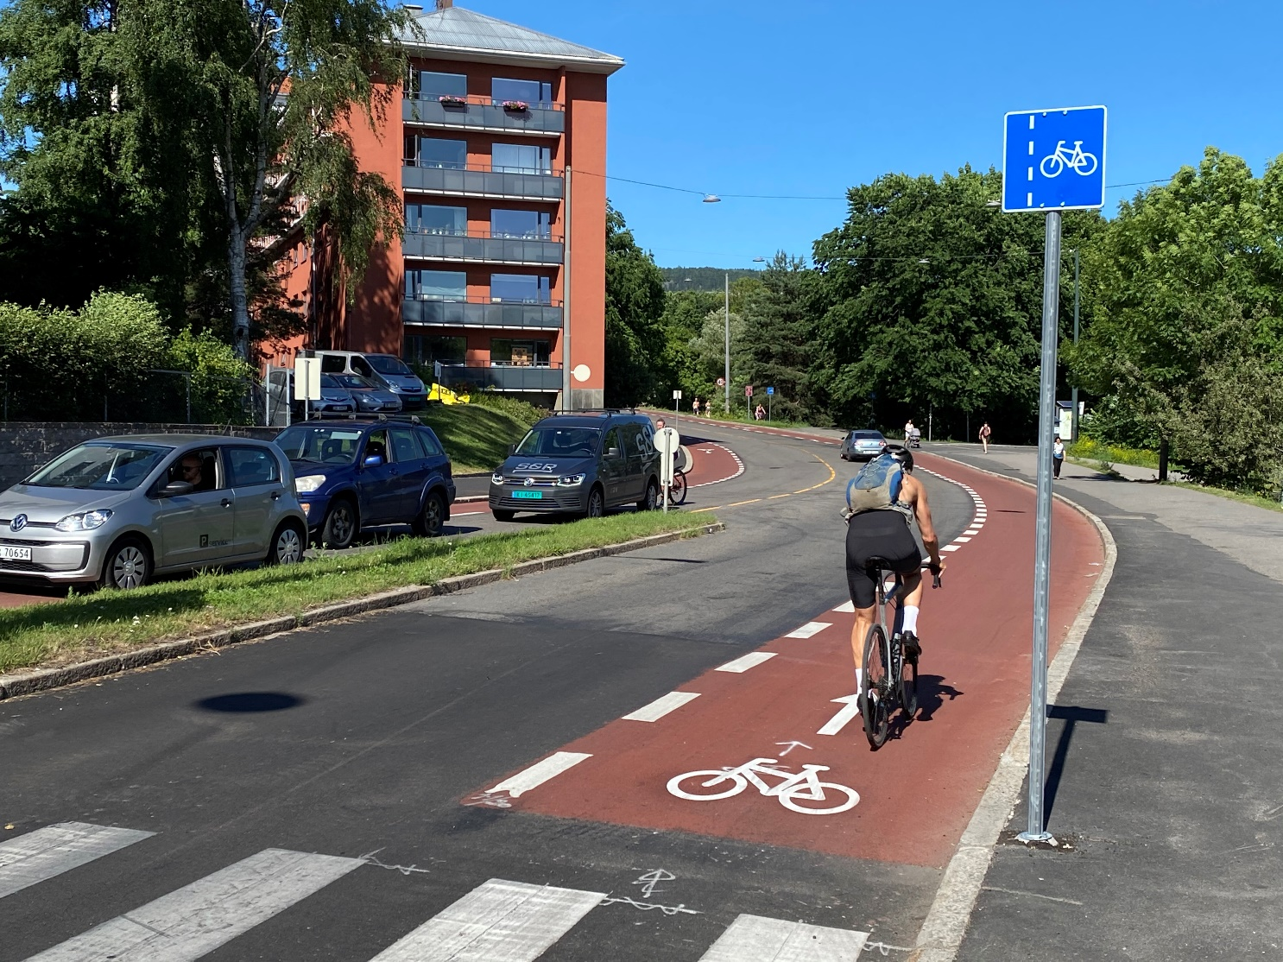
Removing roadblocks
Before 2015:
Installing bike lanes, bus lanes or closing streets to traffic required planning approvals and building permits, which could take years of consultations and public hearings to obtain.
Typically, bike lanes took 5-10 years to implement.
After 2015:
Removing parking to install a bike lane formally only requires a three week technical review.
≈ Tenfold increase in productivity
Notes:
Formerly, the local police department held authority over traffic control signage.
Also, explicit political approval was usually required to remove street parking.
Bike lane implementation has increased from around 1 mile a year, to 10 miles a year.

Slide 15
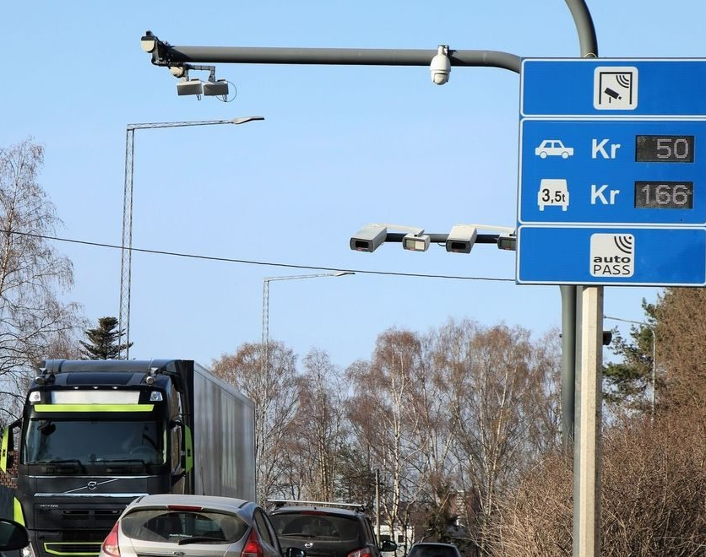
Financing road safety
Since 2015, Oslo has implemented a network of more than 50 digital toll plazas.
The fees pay for the majority of investments in walking, cycling and transit infrastructure, as well as public transit ticket subsidies.
Higher fees during rush hour (congestion prizing)
Higher fees for fossil fuel vehicles.
All together, Oslo earmarks the equivalent of 50 million dollars a year for walking, cycling and road safety investments.
Notes:
Rather than increasing capacity, the norwegian toll system is designed to offset the negative impacts of car traffic.
The fees are supposed to get other drivers off the road, by providing safe and attractive alternatives to driving.

Slide 16
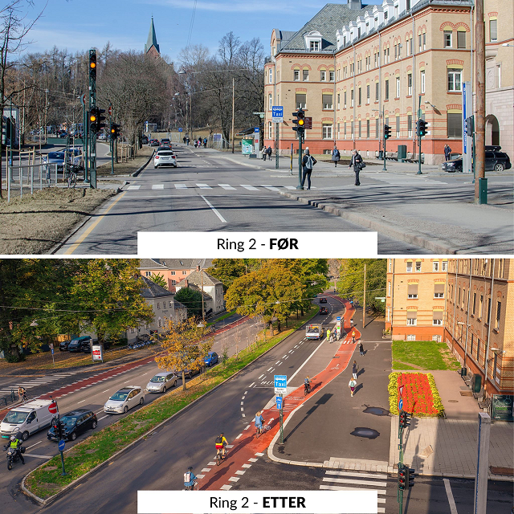
What measures may have made a difference since 2015?
Allowing contraflow cycling
Removing street parking
Installing bike lanes
Installing speed humps
Tightening corner radii at intersections
Improving street lighting
Rebuilding dangerous streets and intersections
The city ring road, before and after bike lane installation. (Photo: City of Oslo)
Notes:
It’s hard to know exactly what measures have contributed the most to improved road safety for pedestrians and cyclists.
These are seven measures that would like to highlight, because they have been sufficiently widespread to have had significant effect.
I’ll cover the first five more thoroughly in the following.
As for street lighting, Oslo is far north, meaning that rush hour happens before sunrise, or after sunset from october to february.
All streets and roads have street lights, and there have been significant improvements in teh last few years.

Slide 17
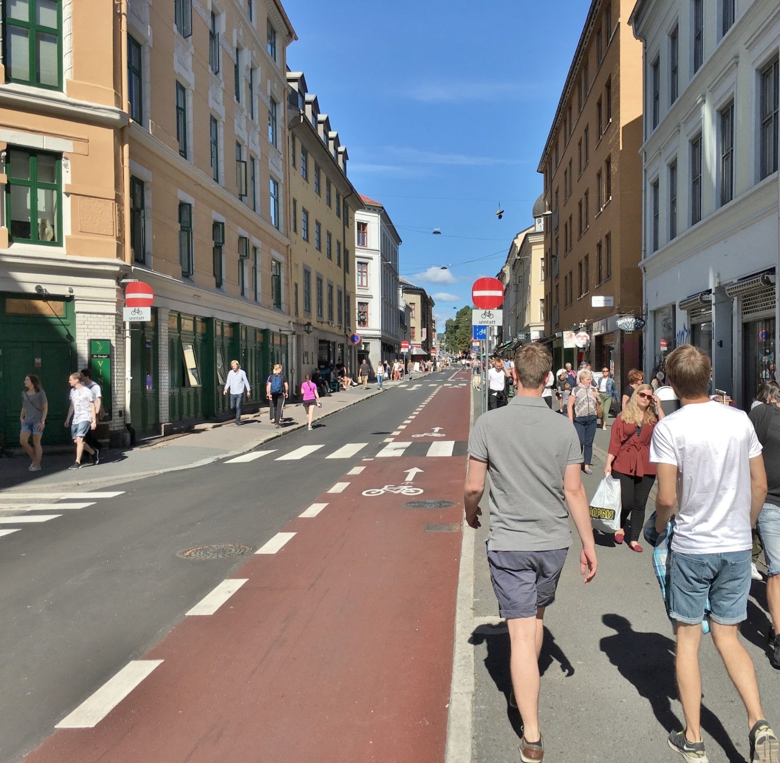
1. Contraflow cycling
2015: Mostly forbidden
Now: Allowed on most streets
Allows cyclists to chose safest or shortest route.
Removes the anxiety of dealing with faster traffic from behind.
Notes:
On this street, one row of parked cars were removed to make way for a contraflow bike lane.
But on low traffic streets, contraflow cycling is usually allowed even without a bike lane.

Slide 18
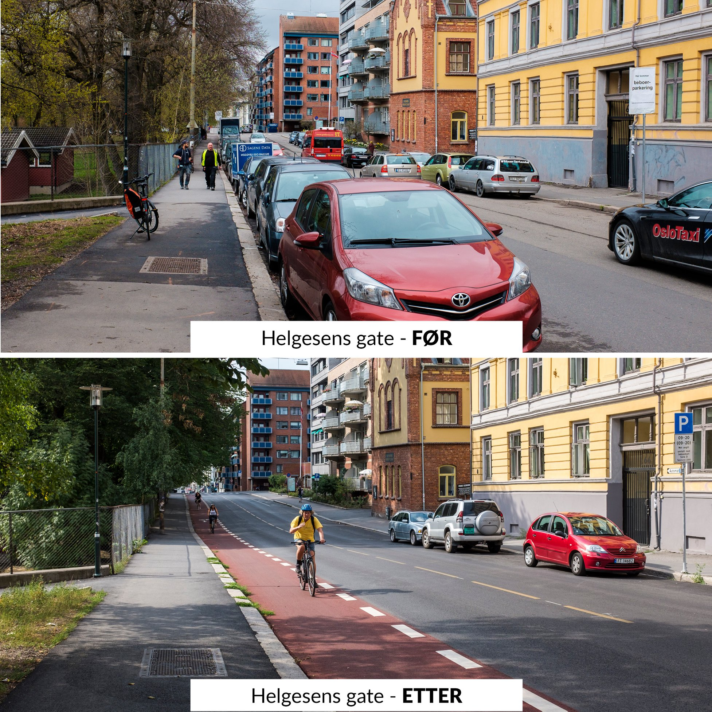
2. Removing street parking
In 2015, the city effectively removed the need for consultations or political approval for removing street parking.
Improves visibility
Causes drivers to increase speeds slightly, but not enough to offset increased safety.
4250 parking spaces removed in five years.
Notes:
Now, removing parking is often quite uncontroversial.

Slide 19
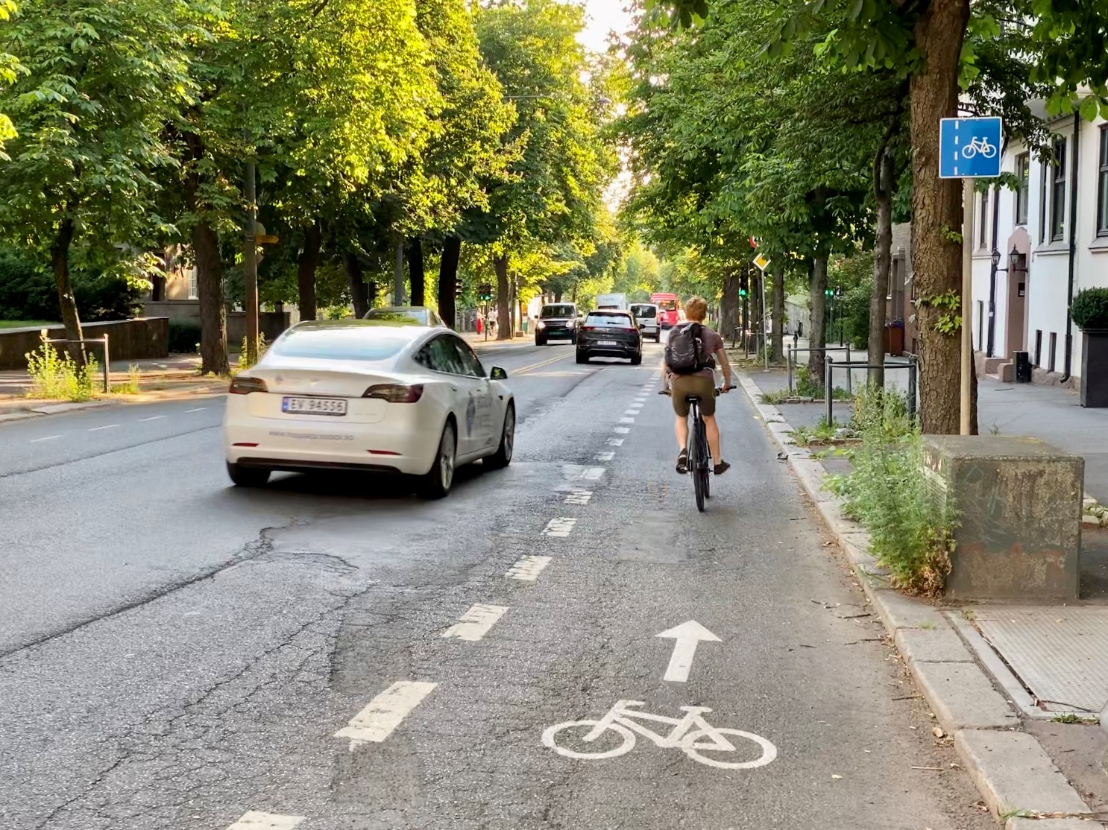
3. Installing bike lanes
While most bike lanes are installed permanently, Oslo also does full scale trials.
Here, a bus lane was removed to make room for a bike lane.
The removal caused major delays for bus traffic.
Now, the street has been closed to car traffic during rush hour.
Notes:
You have seen a few examples of bike lanes already. This is a little different.
Now, it is used by up to a thousand cyclists a day.

Slide 20
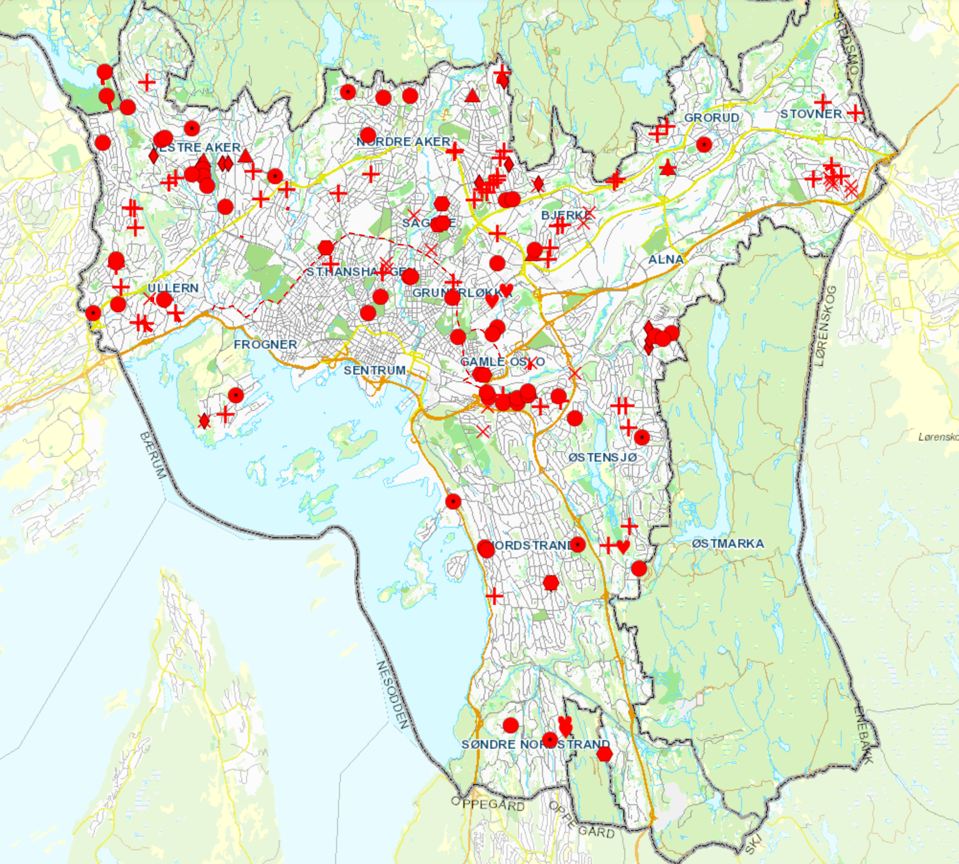
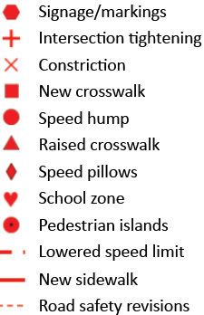
Speed management
Oslo makes hundreds of smaller improvements to speed management every year, in addition to larger projects.
The city relies on street design to enforce speed limits.
Notes:
These measures are usually intended to provide safe routes to school.

Slide 21
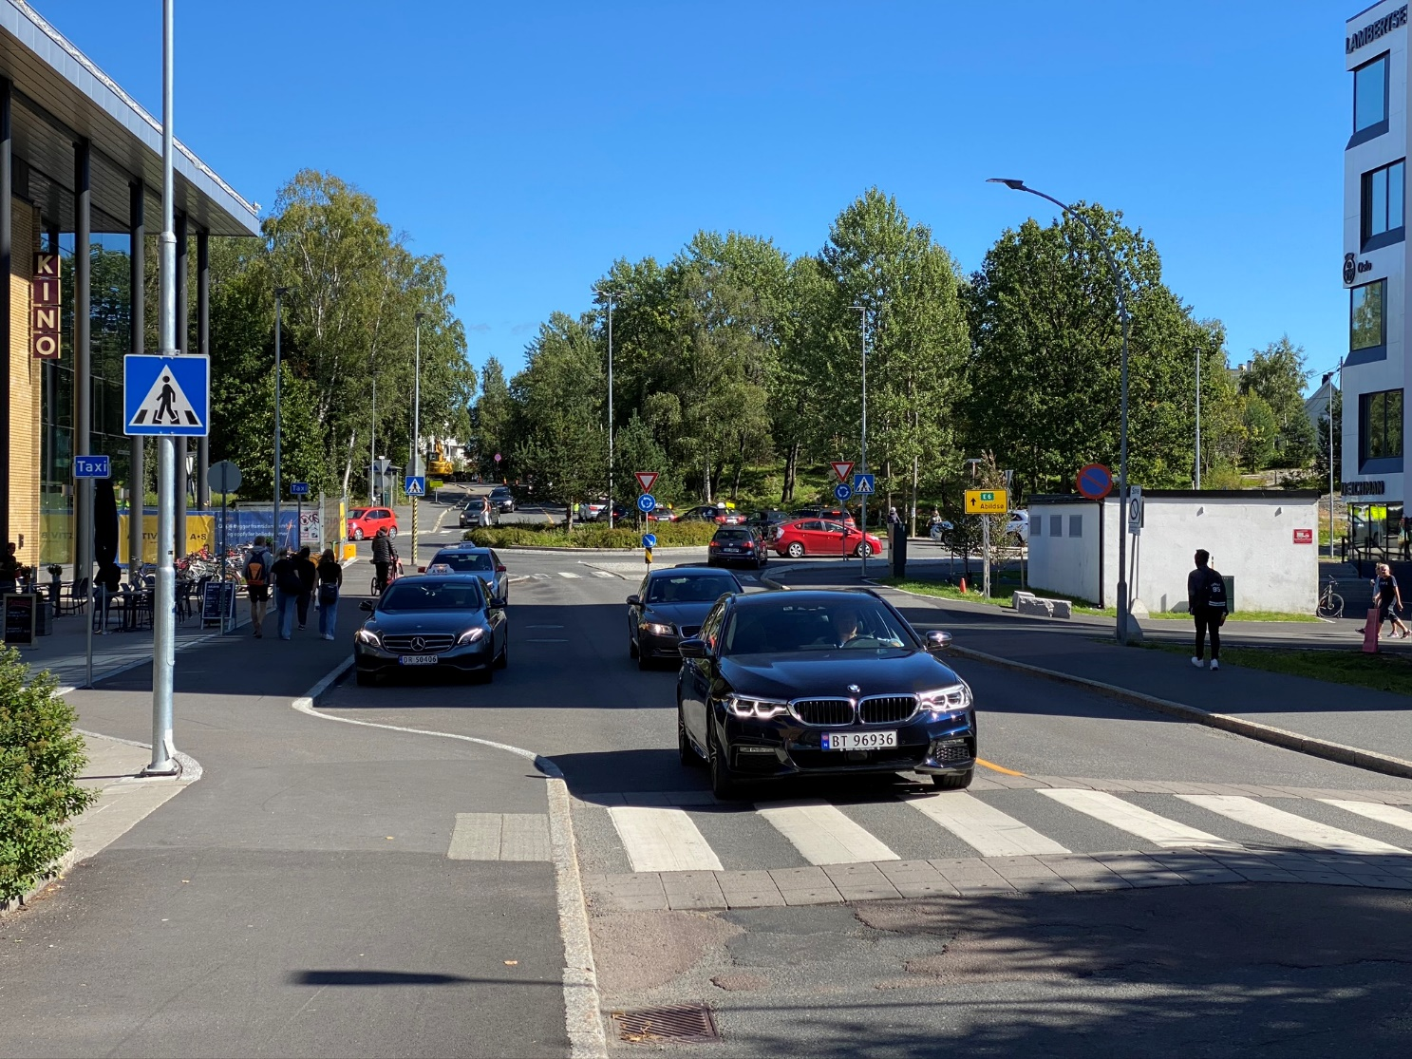
4. Speed humps
Oslo installs about 50 new speed humps and raised crosswalks in 2020.
Used with speed limits up to 31 mph (50 km/h).
Required if more than 15 % of driver exceed the speed limit by more than 3 mph.
Notes:
This shows a typical raised crosswalk outside a shopping mall.

Slide 22
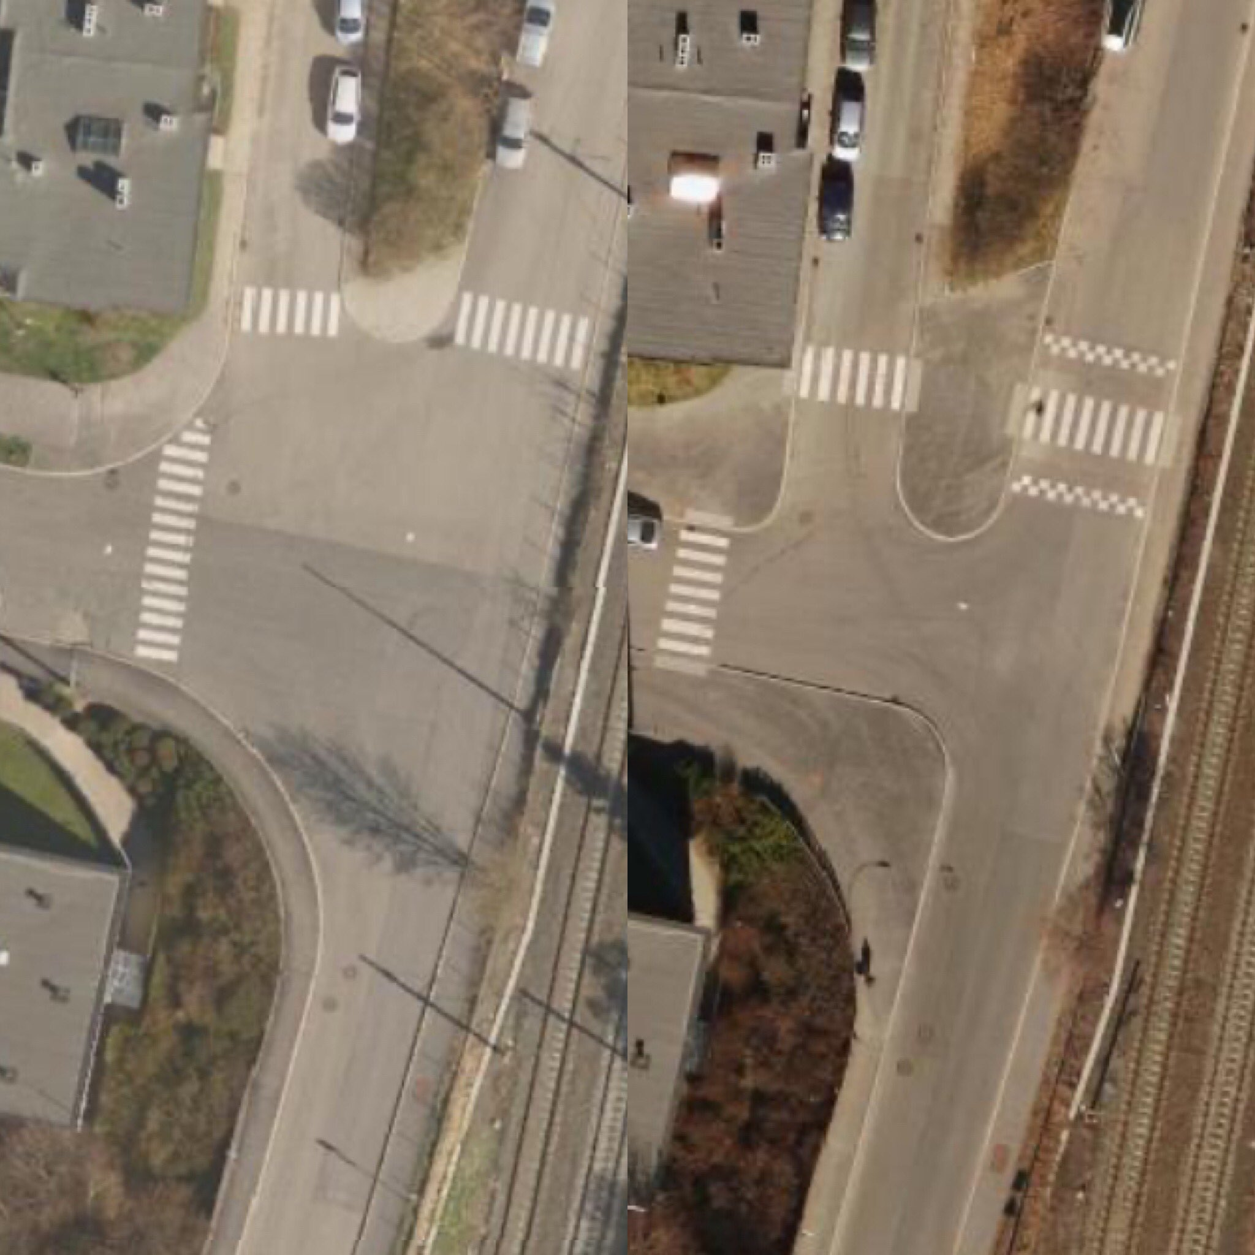
5. Tightening corner radii at intersections
For intersections on smaller streets, Oslo employs small corner radii to keep speeds low.
Every year, dozens of intersections are rebuilt.
This provides more sidewalk space, and shorten crosswalks. The maximum allowed crossing distance is 26 feet (8 meters).
Before
After
Notes:
Note the raised crosswalk.
You can count the zebra stripes to find out the crossing distance in meters. The crossing on the left has been shortened from 14 to 7 meters.

Slide 23
Questions?
Anders Hartmann
anders.hartmann@asplanviak.no / Twitter: @andershartmann

Slide 24
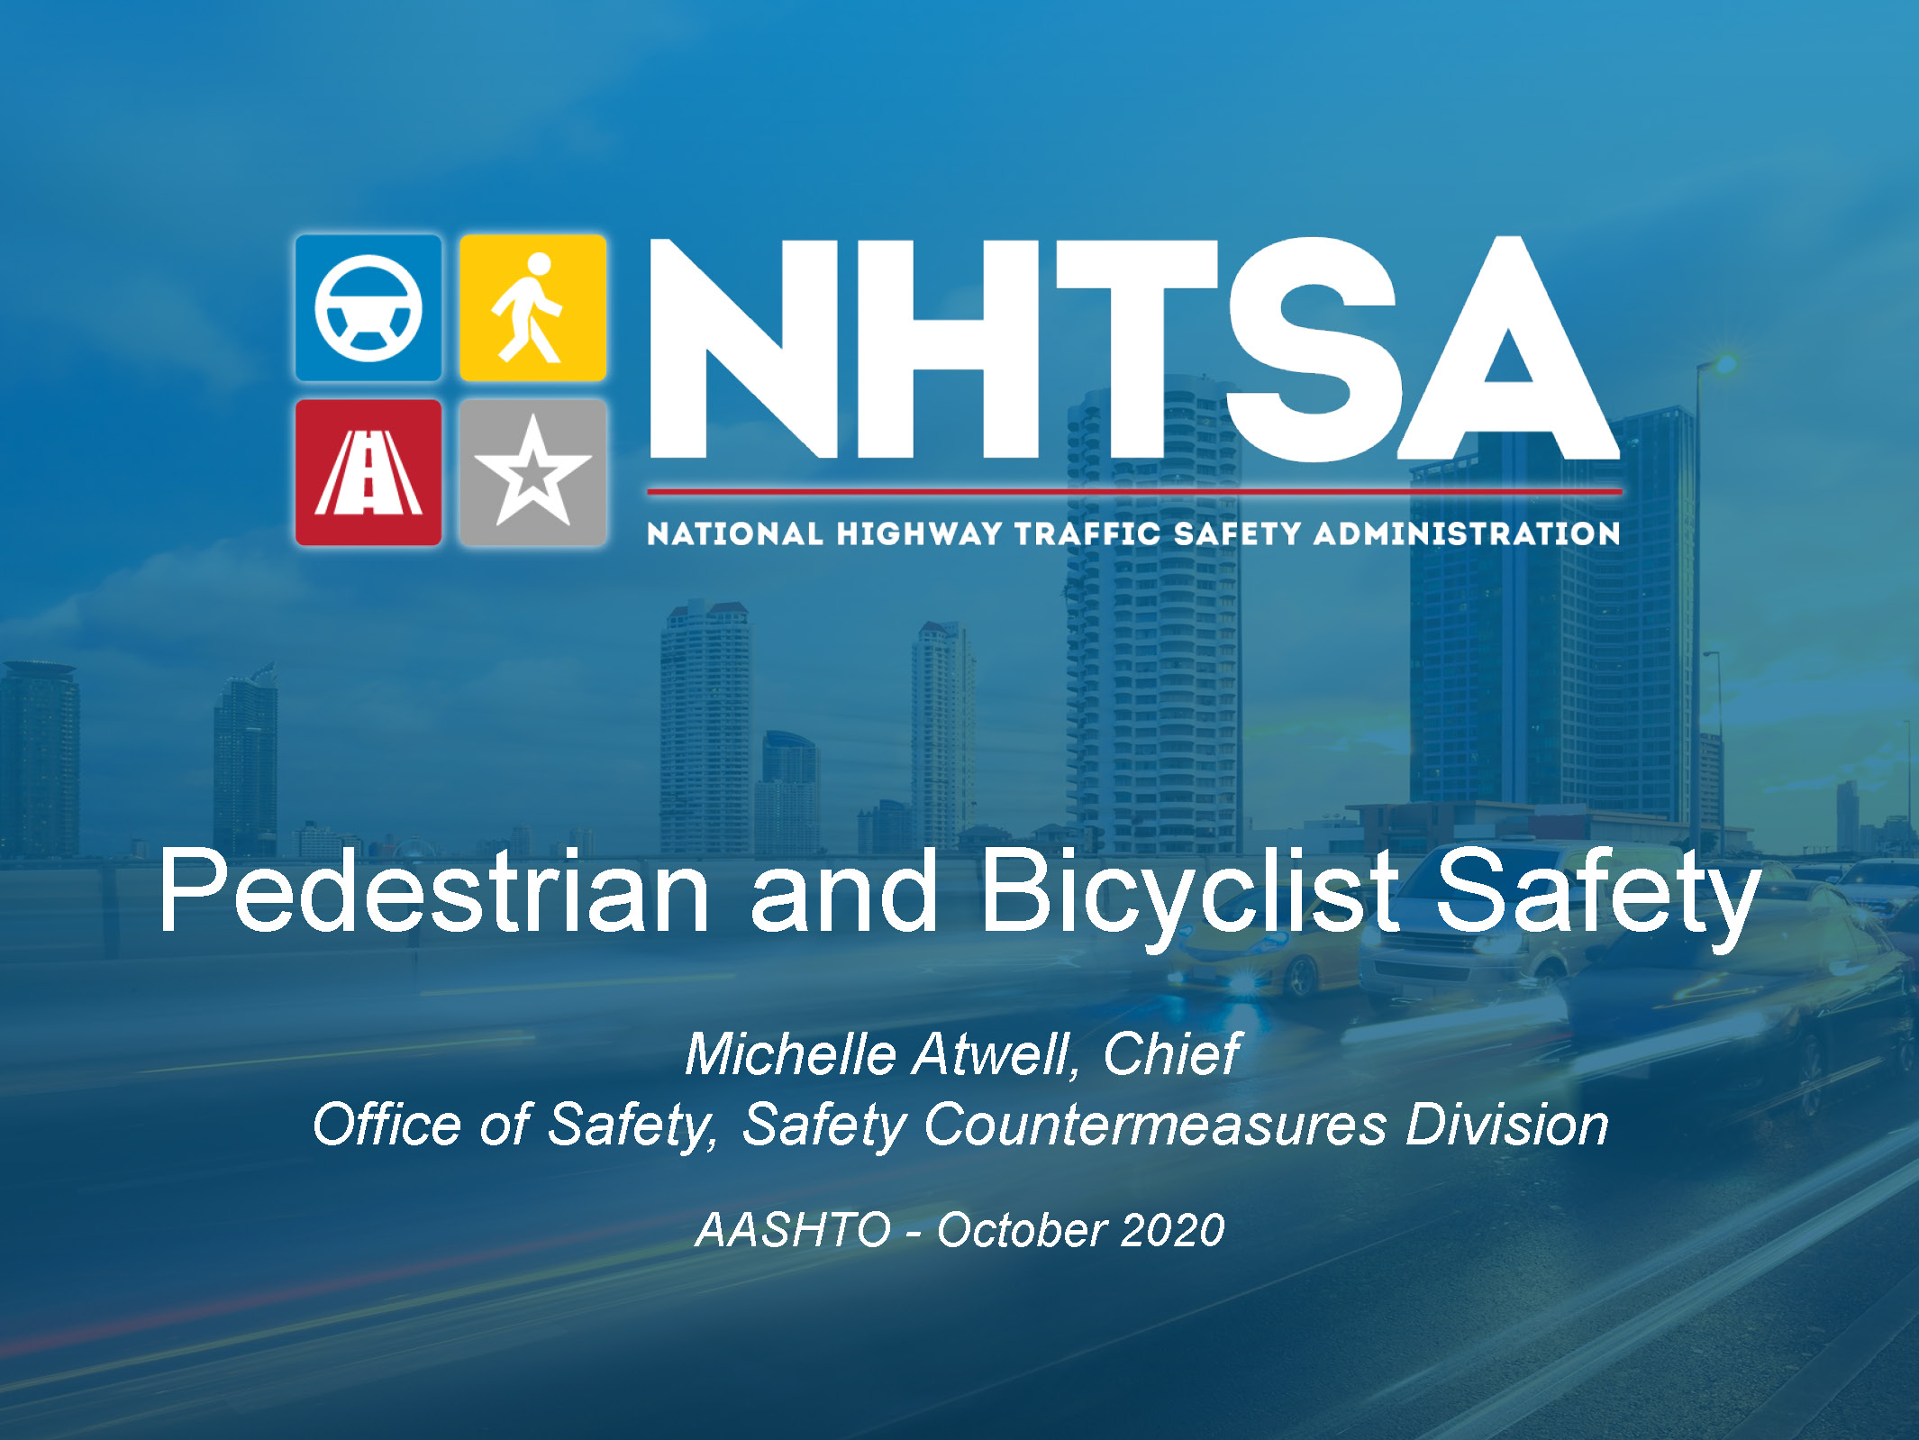

Slide 25
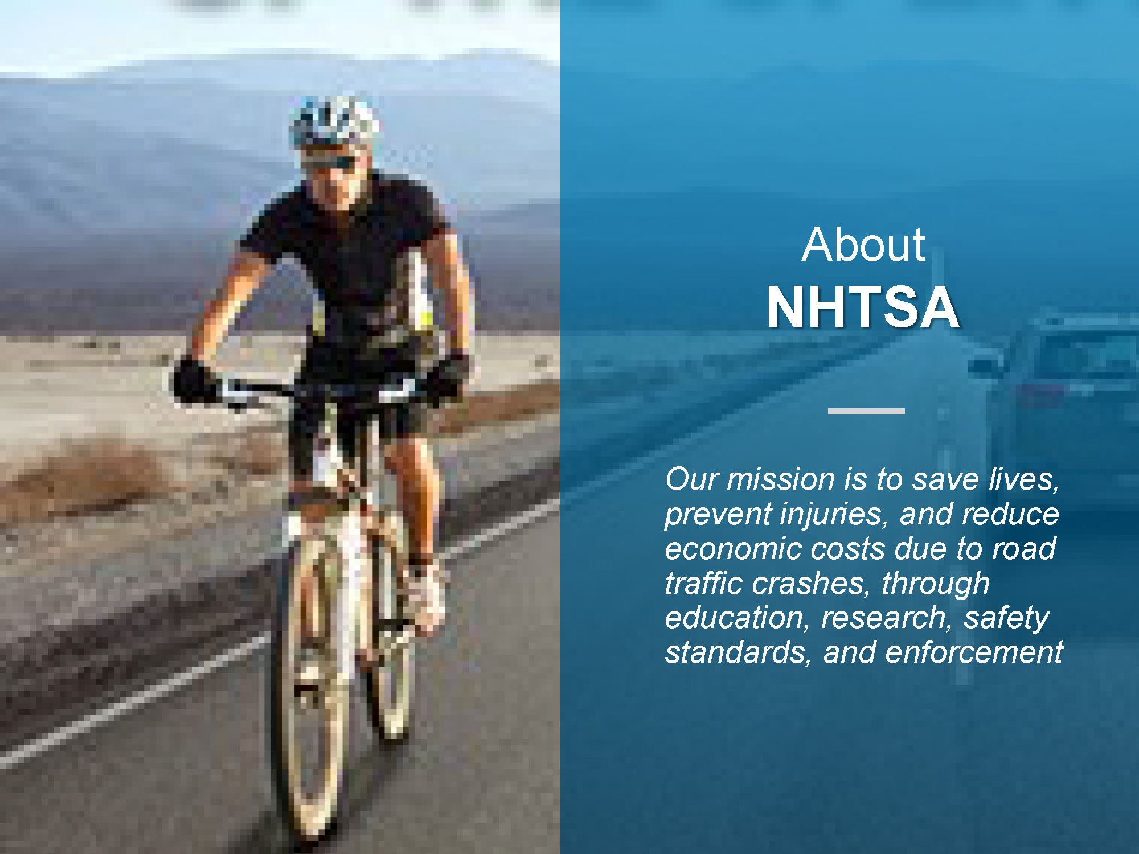

Slide 26


Slide 27
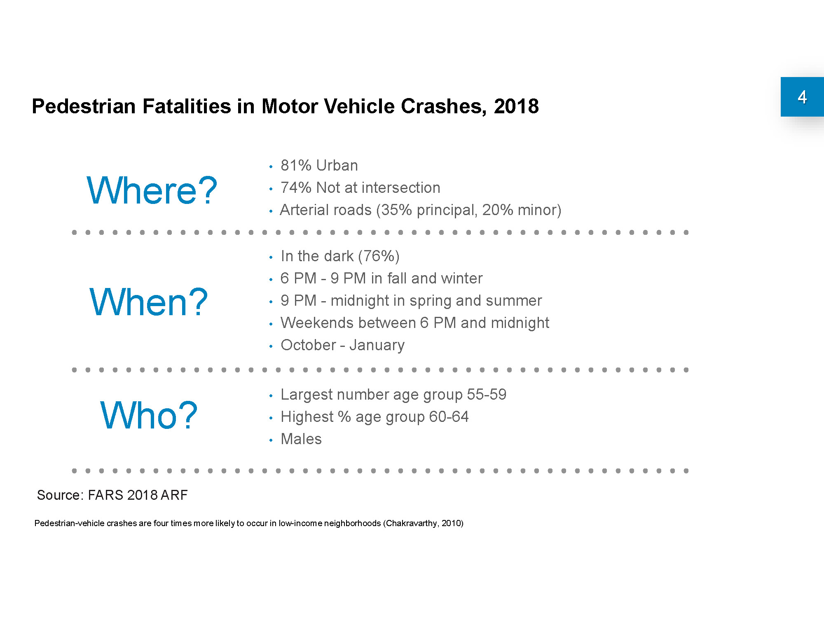

Slide 28
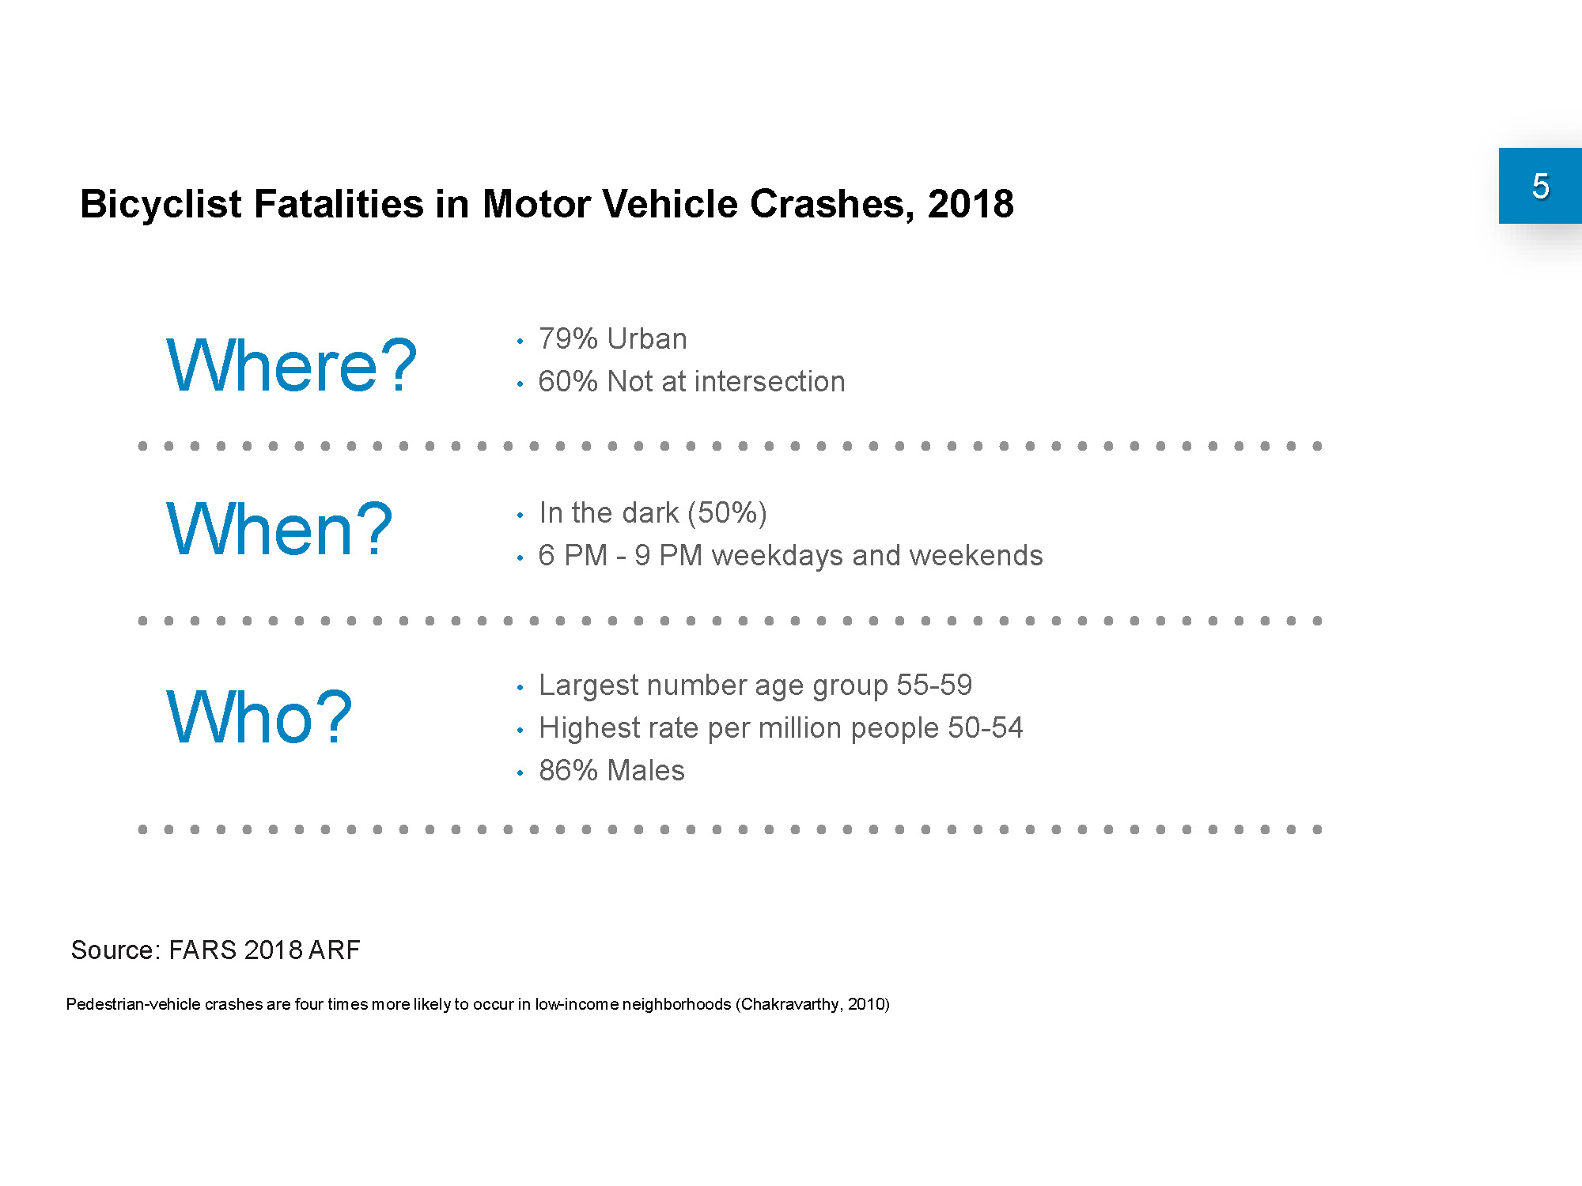

Slide 29
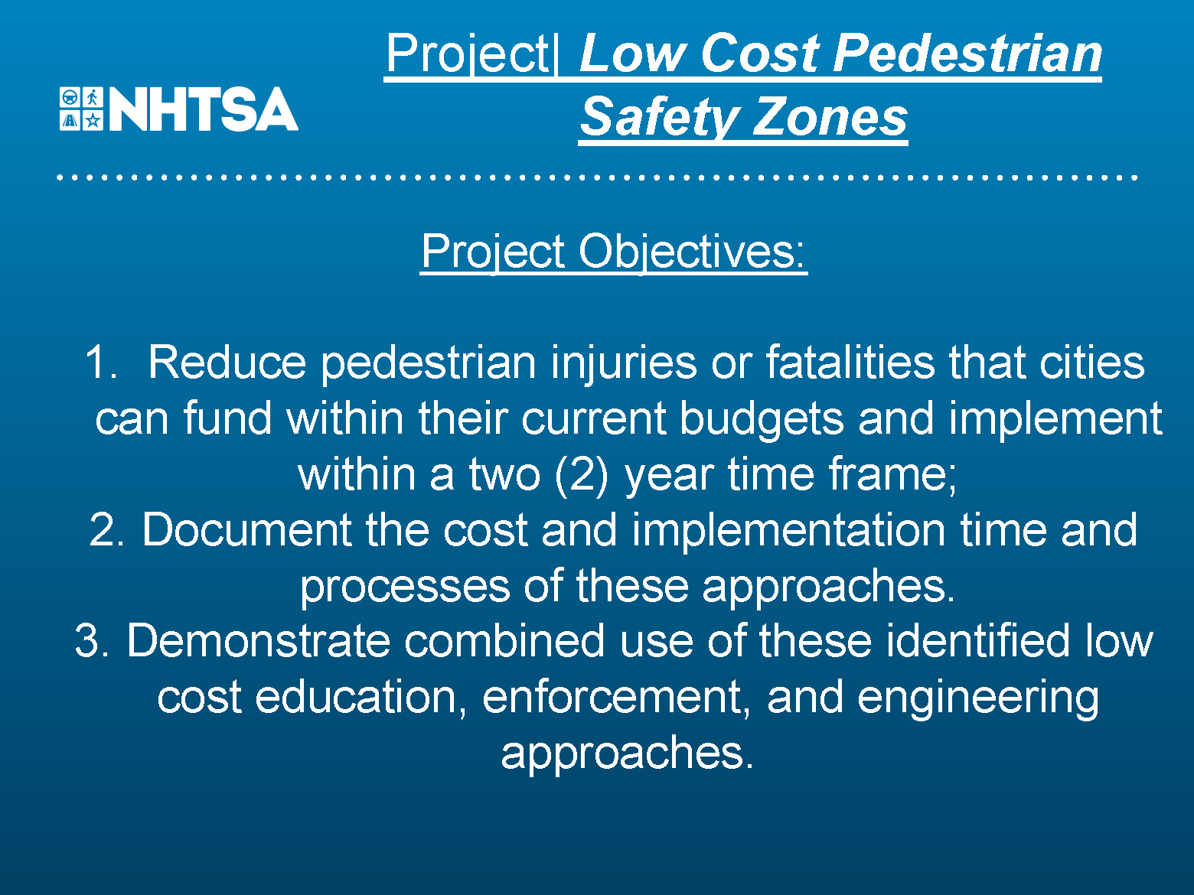

Slide 30
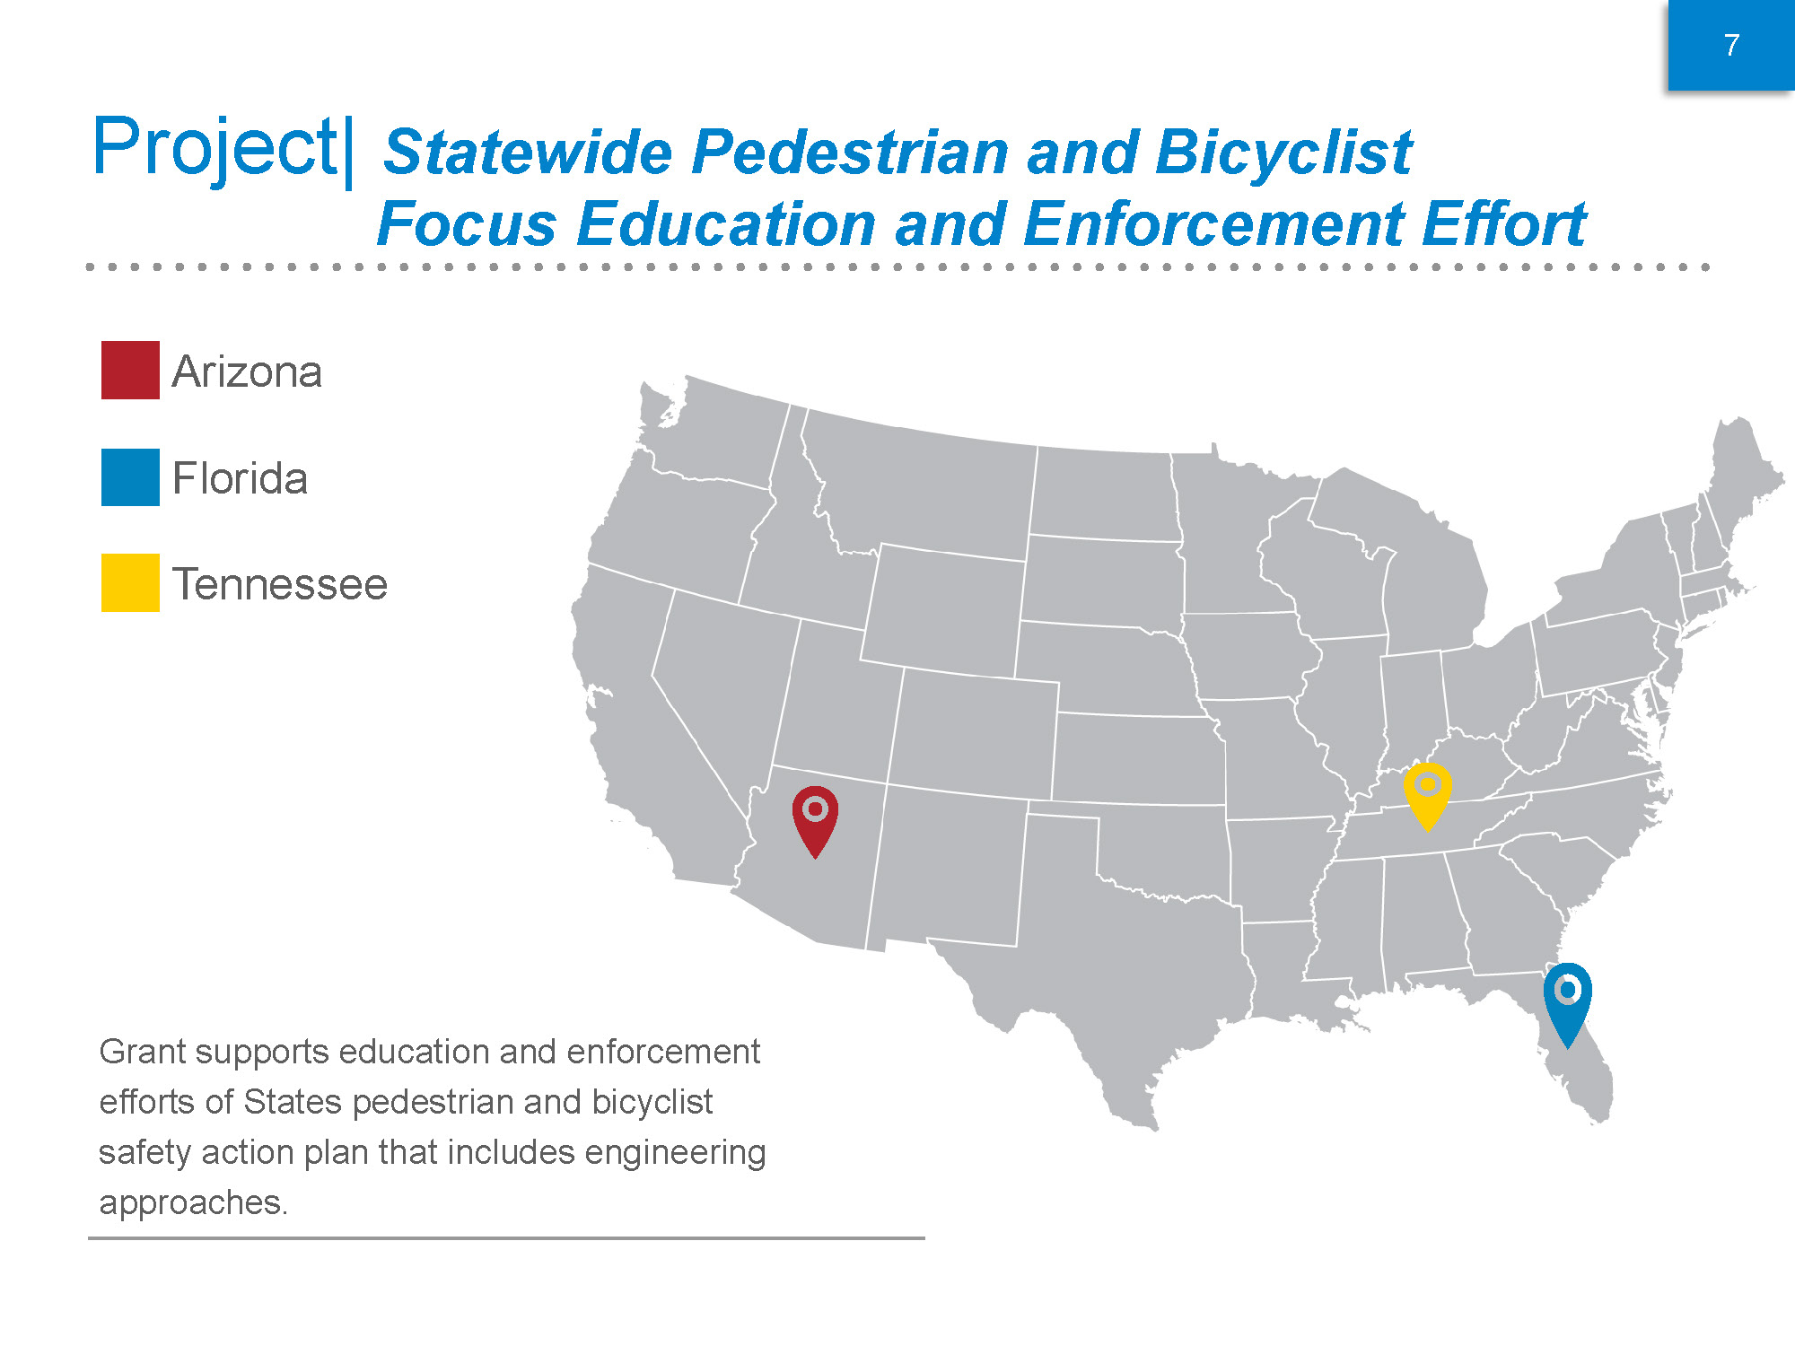

Slide 31
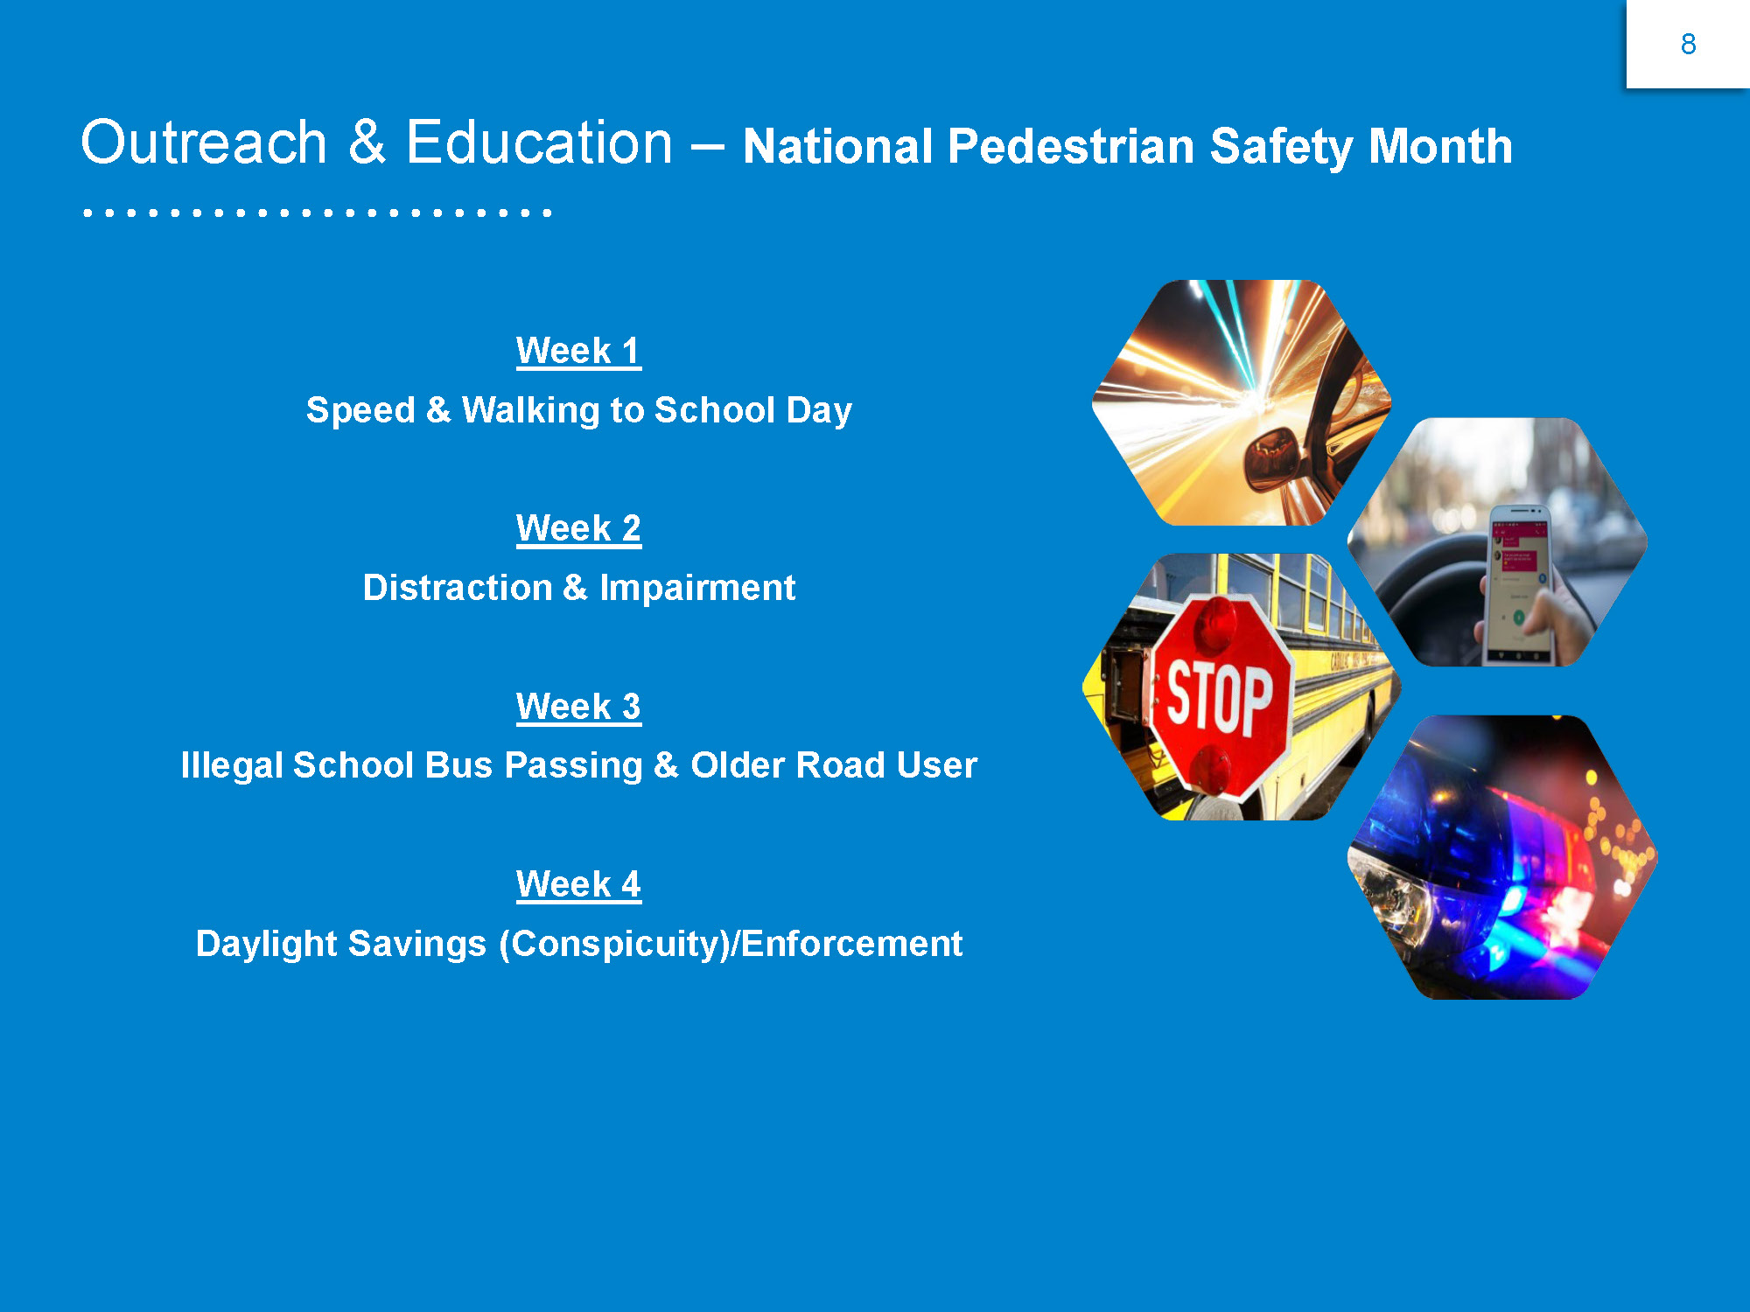

Slide 32
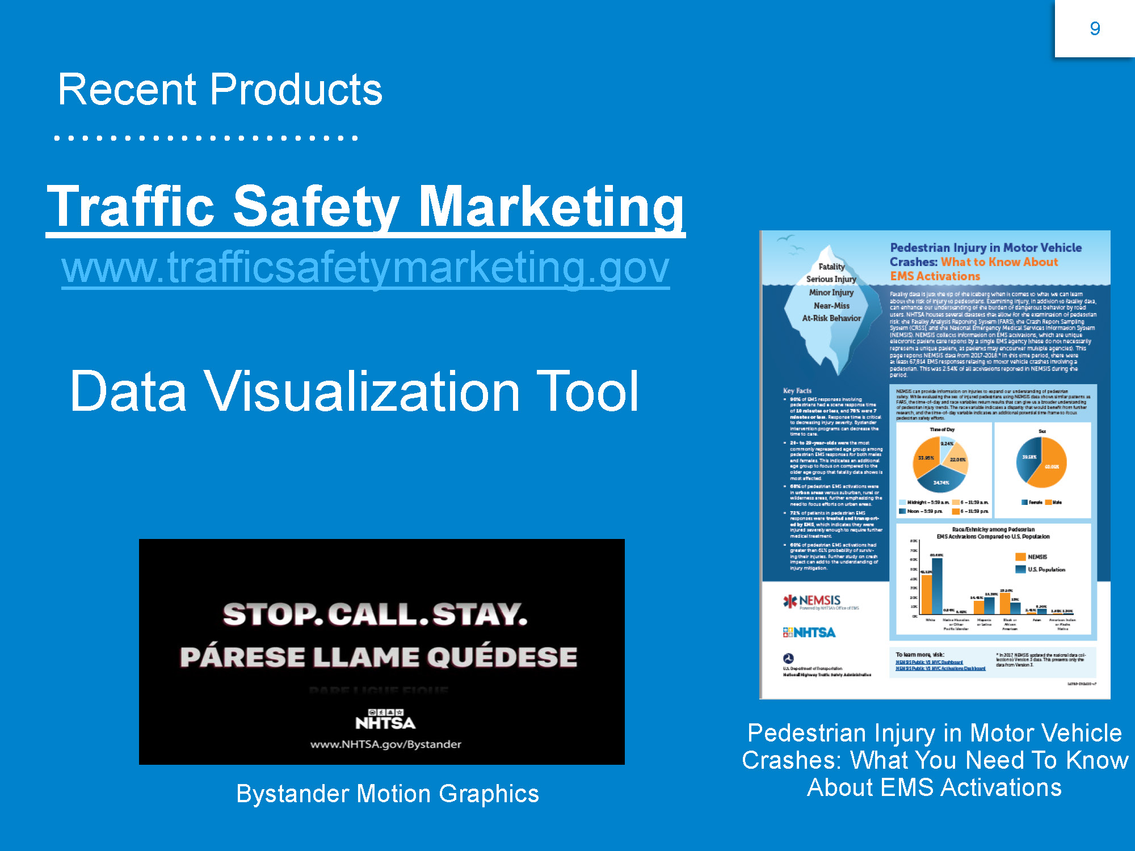

Slide 33
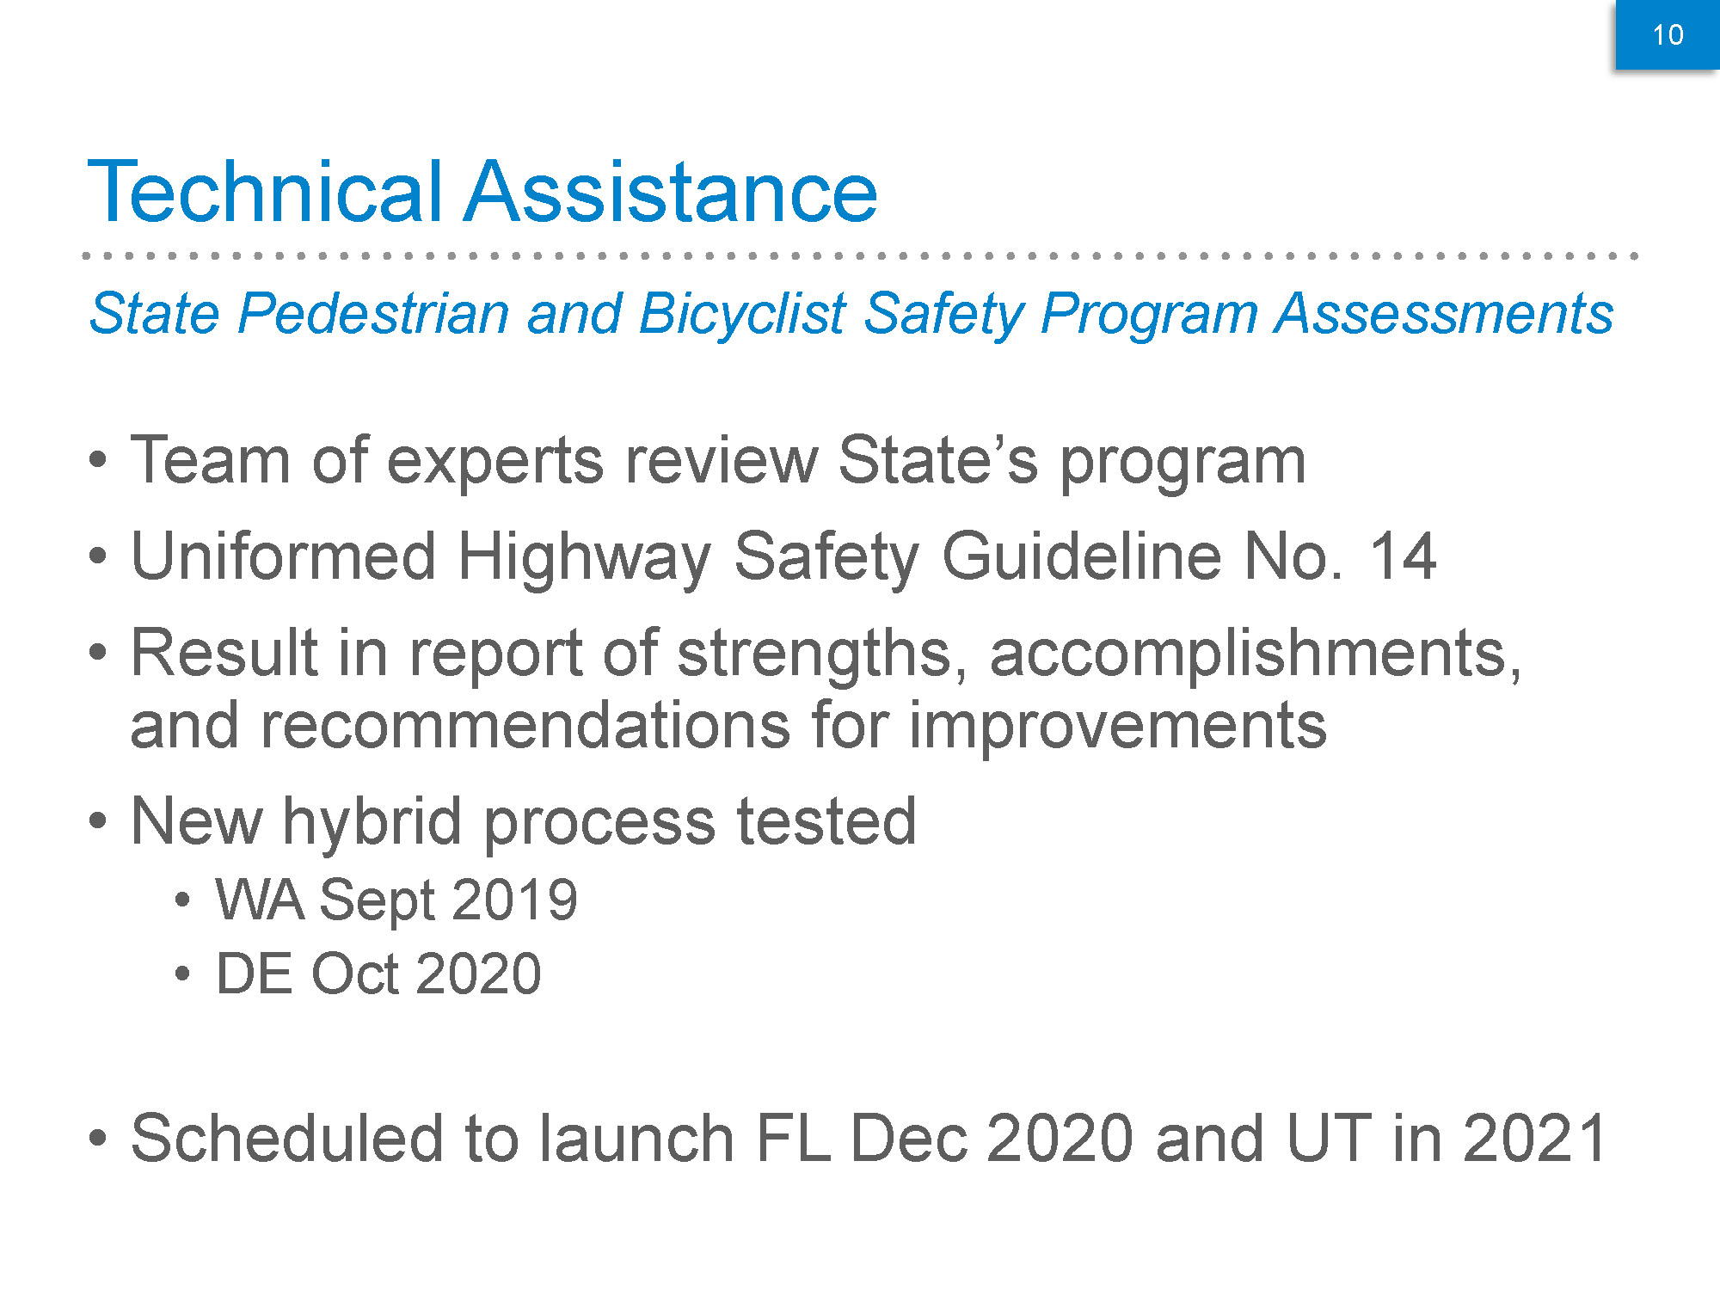

Slide 34
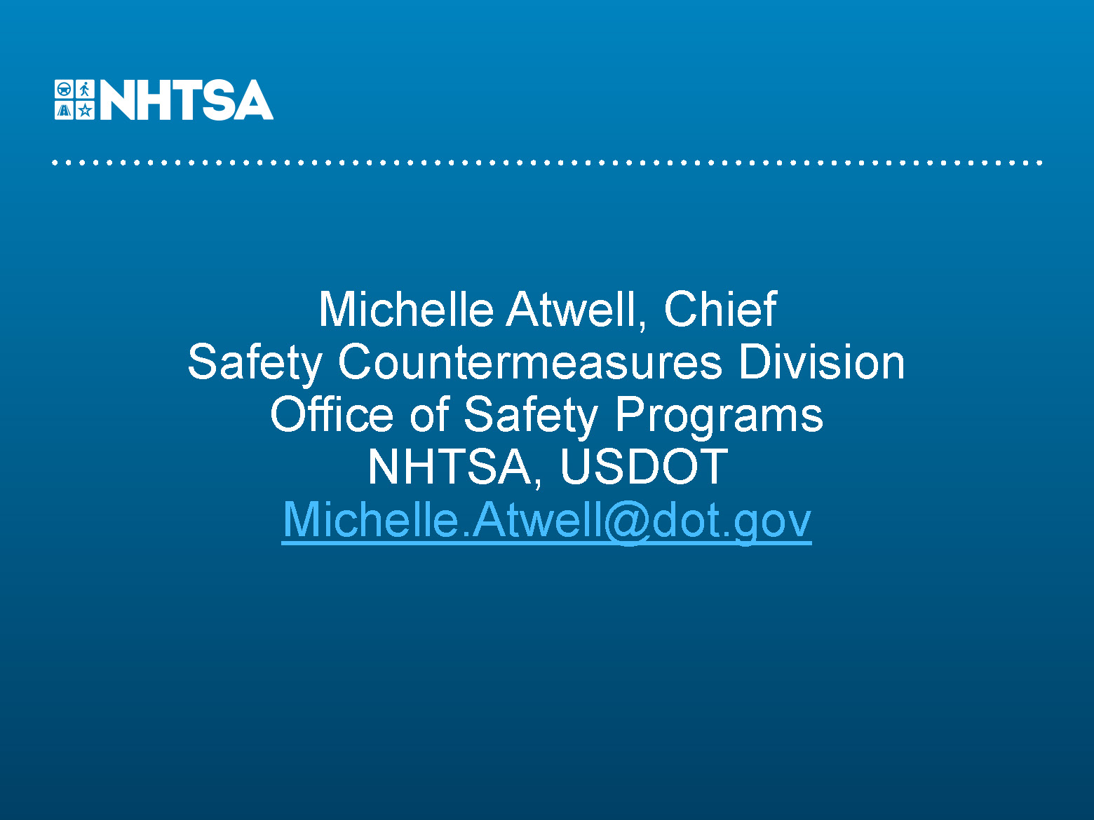

Slide 35
Pedestrian and Bicyclist Safety Resources
Michael S. Griffith RSP₁, RSP₂
Federal Highway Administration

Slide 36
Resources Available to Help Improve Pedestrian and Bicyclist Safety
Pedestrian and Bicycle Safety Focus States Efforts
Smartphone-Based Mid-Block Pedestrian Crossing In-Vehicle Warning
Updated Pedestrian and Bicyclist Road Safety Audit Guide
and Prompt List
Speed Management Noteworthy Practices
Pedestrian and Bicycle Scalable Risk Assessment Methodology
and Areawide Exposure Tool
Bikeway Selection Guide
USDOT Action Plan
Safe Transportation for Every Pedestrian (STEP)

Slide 37
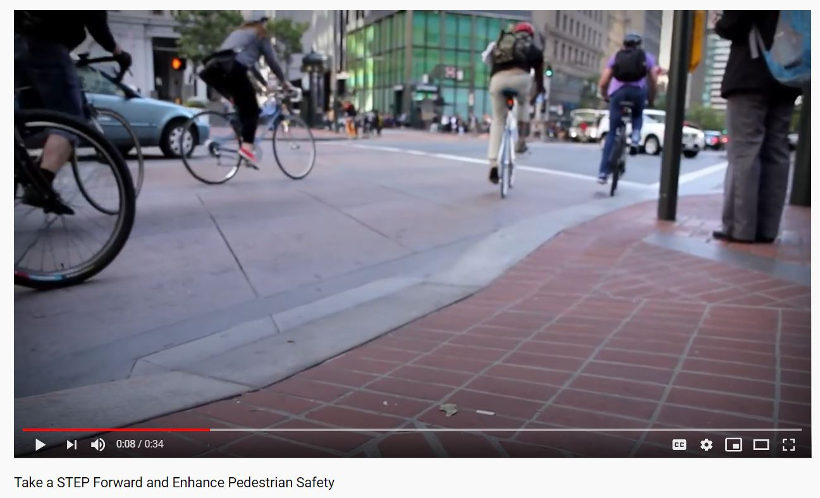
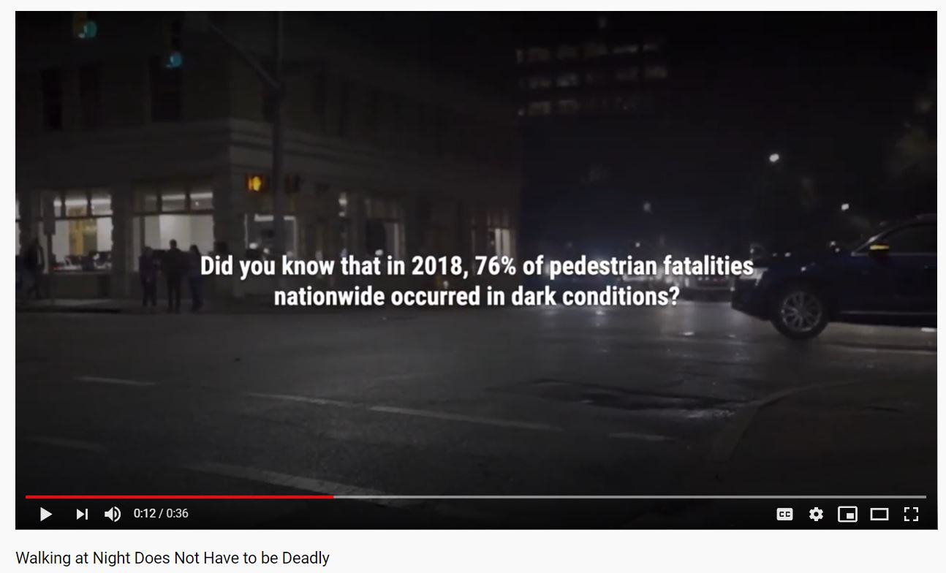
FHWA Administrator Nicole R. Nason’s priority on Pedestrian Safety
Take a STEP Forward and Enhance Pedestrian Safety
https://www.youtube.com/watch?v=WFj0ID8itLs&feature=youtu.be
Walking at Night Does Not Have to be Deadly https://www.youtube.com/watch?v=3zQEzASZ2gM&feature=youtu.be

Slide 38
Pedestrian and Bicycle Safety - Focused Approach Effort
FHWA has been providing extra resources to States and cities with the highest pedestrian and bicyclist fatalities and fatality rates.
Assist in the development of pedestrian and bicycle safety action plans.
Offer technical assistance and training on how to design safe facilities.
We are in process of doing a “Refresh” of the Focused Approach to Safety. Have gone through a few different rounds since 2004.

Slide 39
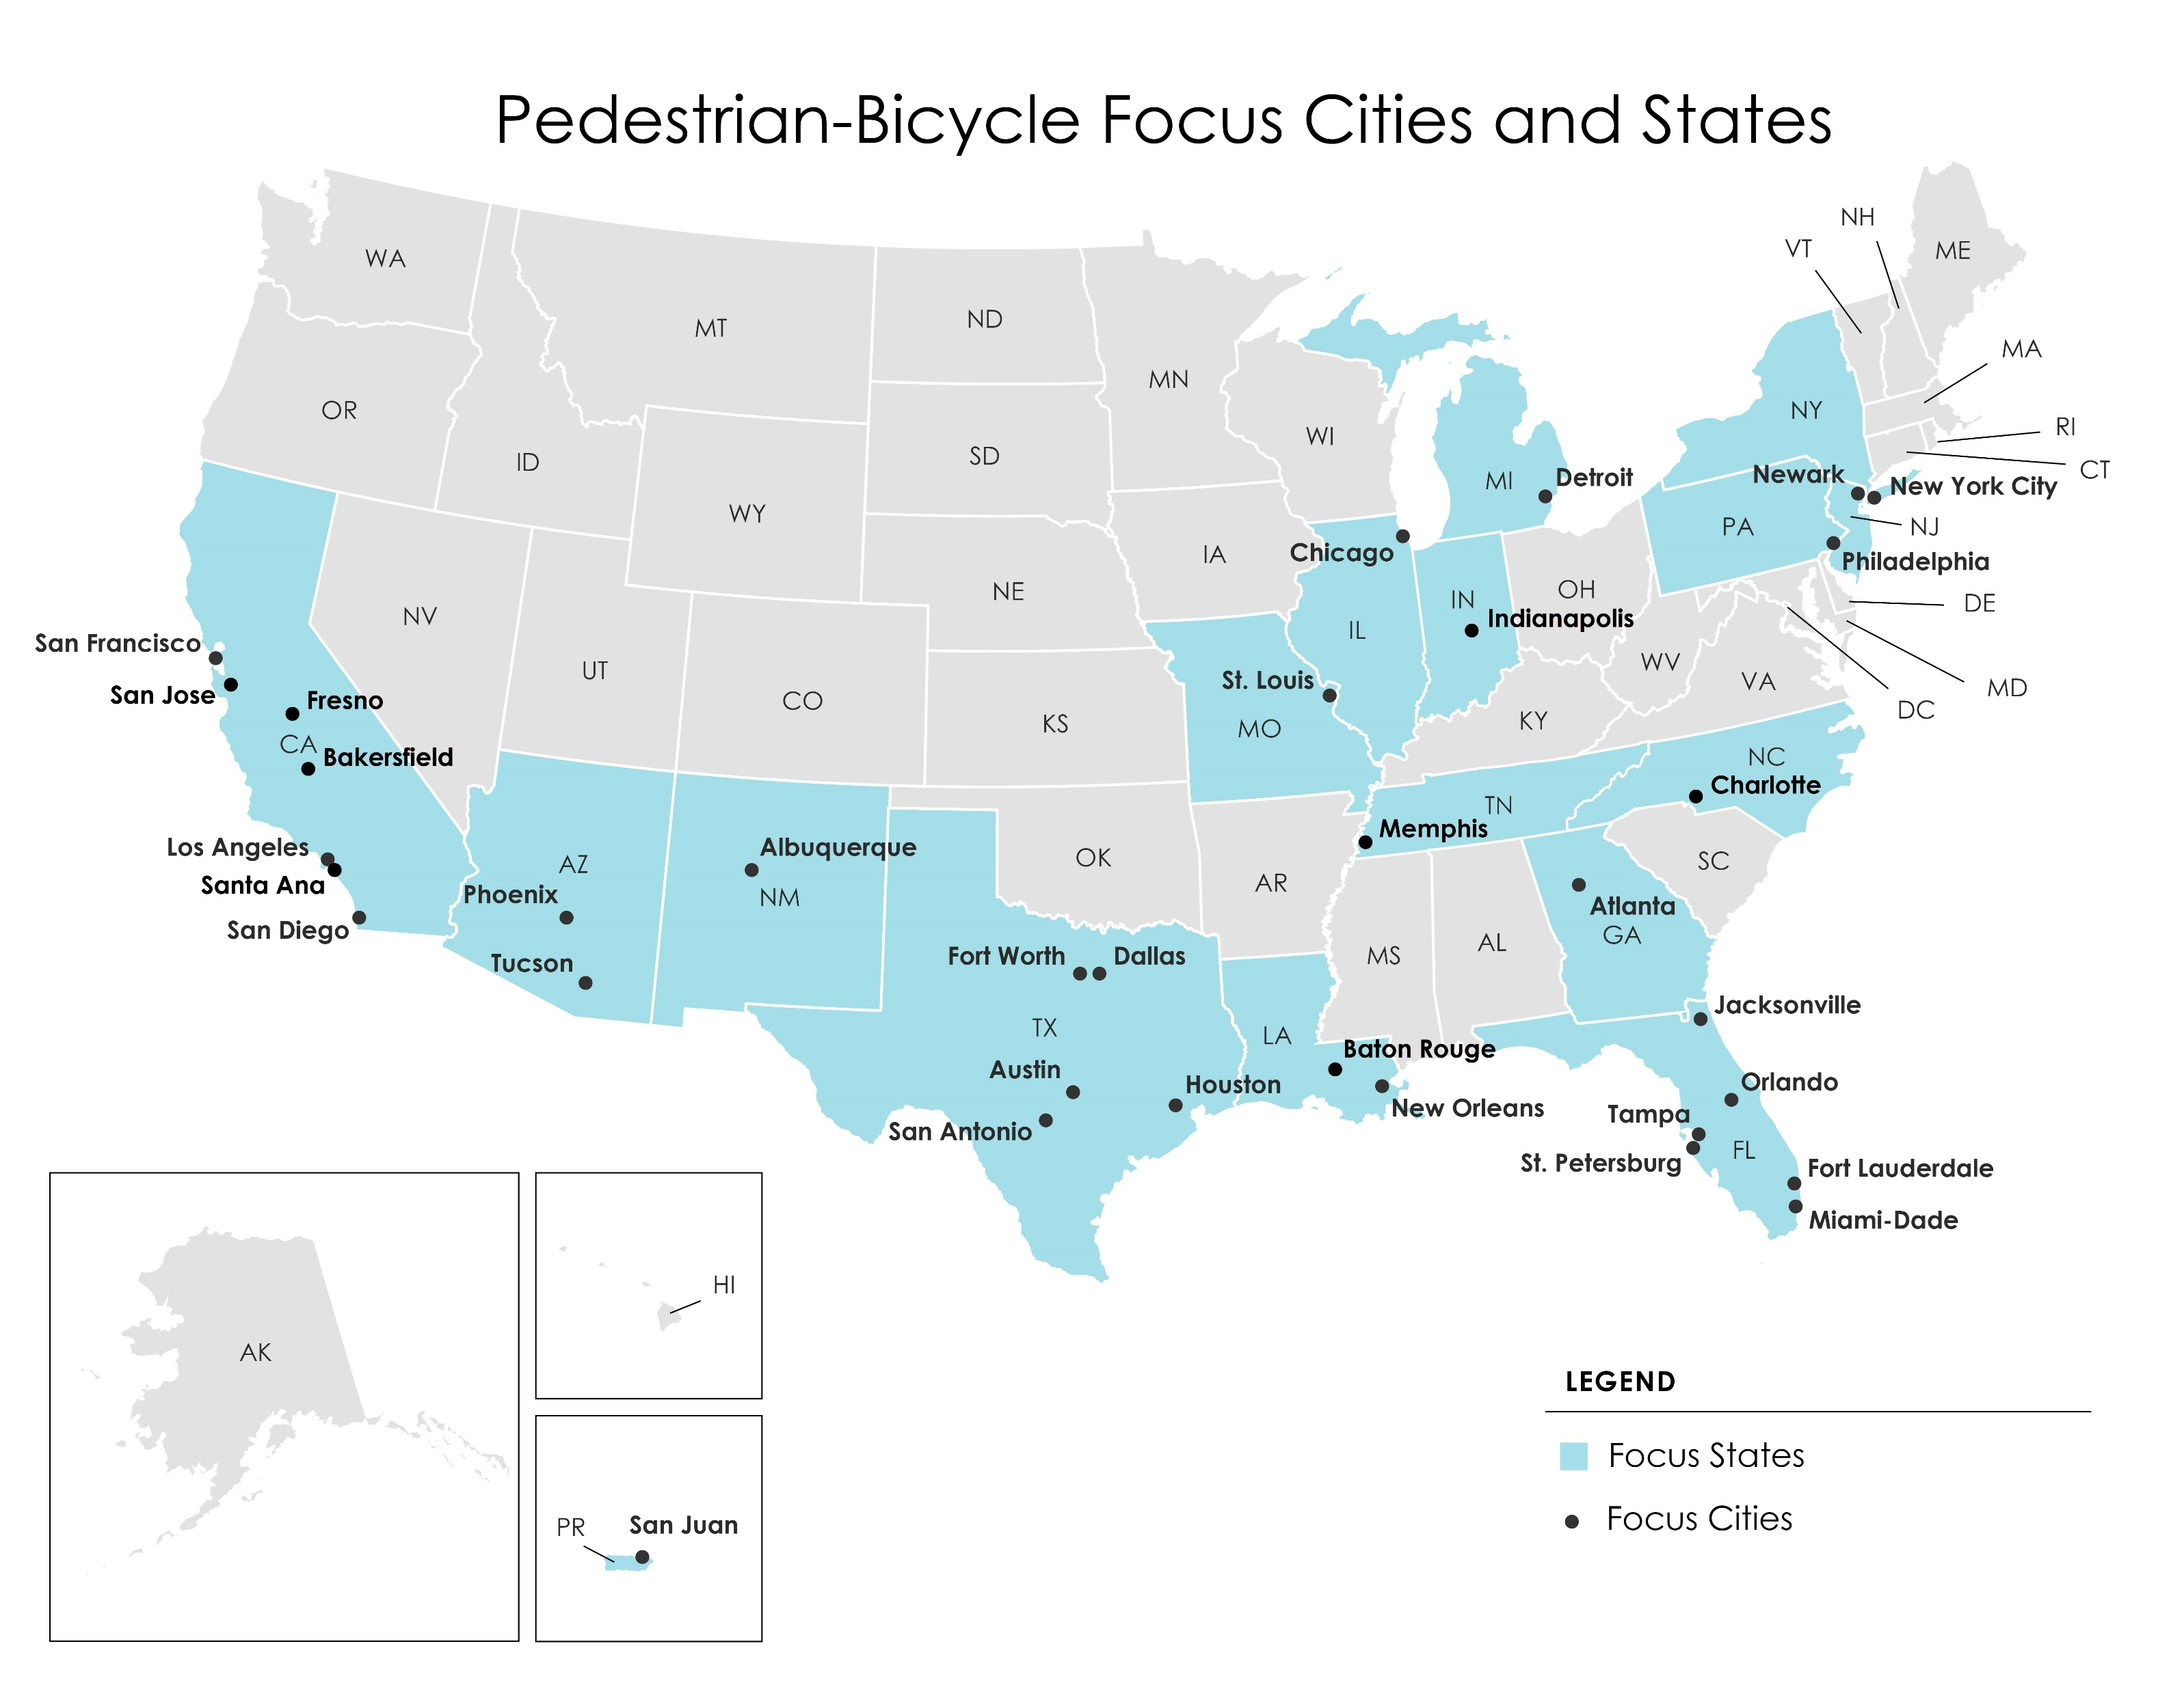

Slide 40
Pedestrian and Bicycle Safety Focus States and Cities
  Over 300 training courses delivered
  Over 6,000 people trained
  Webinars and peer exchanges
  Pedestrian and bike safety action plan development
  Assisted with Crash data analysis and countermeasure selection
  Executive briefings

Slide 41
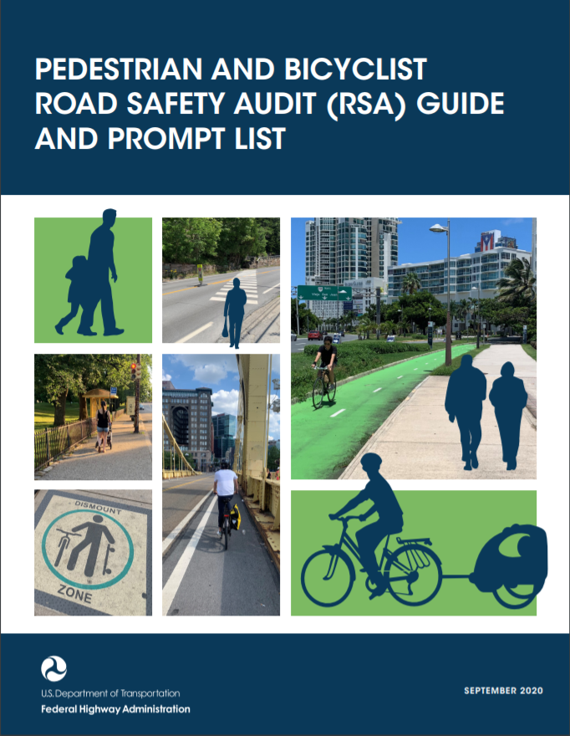
Pedestrian and Bicyclist Road Safety Audit Guide
Intended to support agencies that are interested in conducting pedestrian- and bicycle-focused RSAs.
Includes information on safety risks for both modes, the RSA process, necessary data, and the roles and responsibilities of the RSA Team.
Includes prompt lists for pedestrians and bicyclists to use in the field.
This guide helps practitioners understand pedestrian and bicyclist issues in their jurisdiction and potentially achieve other goals in addition to safety.

Slide 42

Speed Management
Noteworthy Practices
Agencies who want to address speeding are often faced with a lack of resources in setting appropriate speeds for conditions, pushback on changing speed limits, a lack of resources for countermeasures or enforcement, and restrictions or opposition to automated enforcement.
The report provides another avenue of information for practitioners in that it summarizes eight case studies which highlight noteworthy practices from across the U.S. over a range of speed management issues.

Slide 43
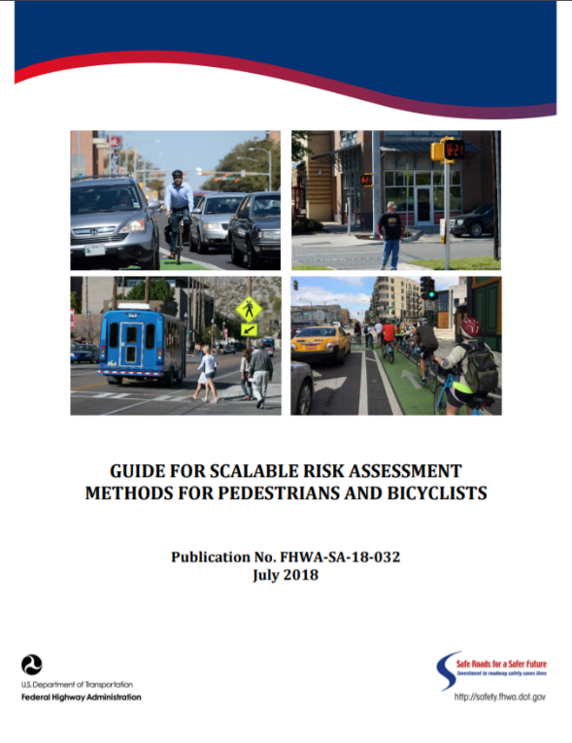
Scalable Risk Assessment Methodology
Use risk assessment methods to evaluate pedestrian and bicyclist risk at different geographic scales
Outlines eight sequential steps to develop risk values
Spreadsheet tool to estimate statewide and MPO area non-motorized exposure
Technical Assistance
Notes:
The Federal Highway Administration (FHWA) recently published the Guide for Scalable Risk Assessment Methods for Pedestrians and Bicyclists (Report No. FHWA-SA-18-032), which outlines eight sequential steps to develop risk values, and describes the scope and nature of each step, including guiding principles. Practitioners can use these scalable risk assessment methods to evaluate pedestrian and bicyclist risk at different geographic scales to inform program and project funding decisions.
An accompanying spreadsheet tool to estimate statewide and MPO area nonmotorized exposure is available online, and is based on combining data from the American Community Survey and the National Household Travel Survey. Finally, FHWA is providing technical assistance through mid-2020 for states, cities, communities and metropolitan planning organizations interested in implementing these risk assessment and exposure estimation approaches.

Slide 44
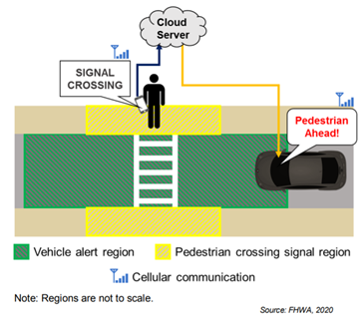
Smartphone-Based Mid-Block Pedestrian Crossing In-Vehicle Warning
Allows pedestrians to signal their intent to cross at a marked midblock crossing when they are within a predefined region surrounding an enabled crosswalk.
Pedestrian crossing signal triggers a warning message that is sent to drivers using the same app within a geofenced region around the crosswalk.
The warning notifies drivers that a pedestrian is ahead to improve driver awareness and prepare drivers to yield.
Intended to increase the driver’s awareness of the potential need to stop and allow the pedestrian to cross.

Slide 45
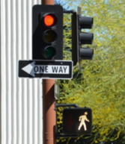
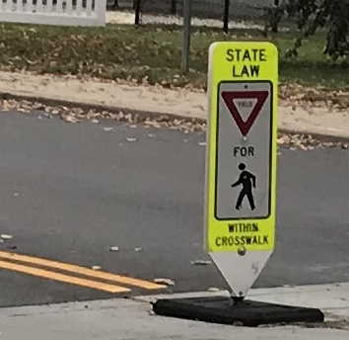
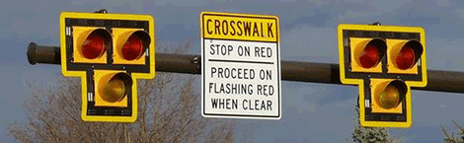
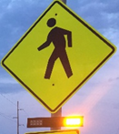


https://safety.fhwa.dot.gov/ped_bike/step/resources/

Slide 46
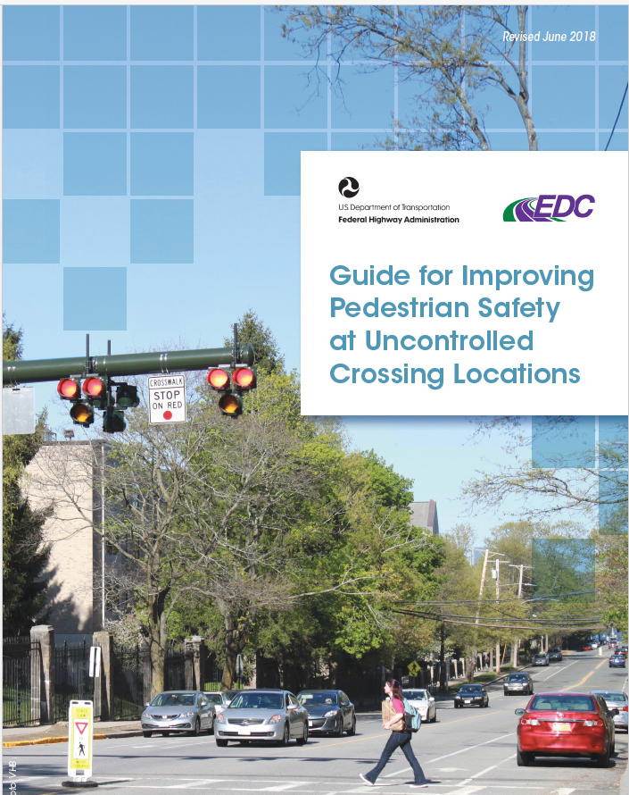
STEP Guide
https://safety.fhwa.dot.gov/ped_bike/step/docs/STEP_Guide_for_Improving_Ped_Safety_at_Unsig_Loc_3-2018_07_17-508compliant.pdf

Slide 47
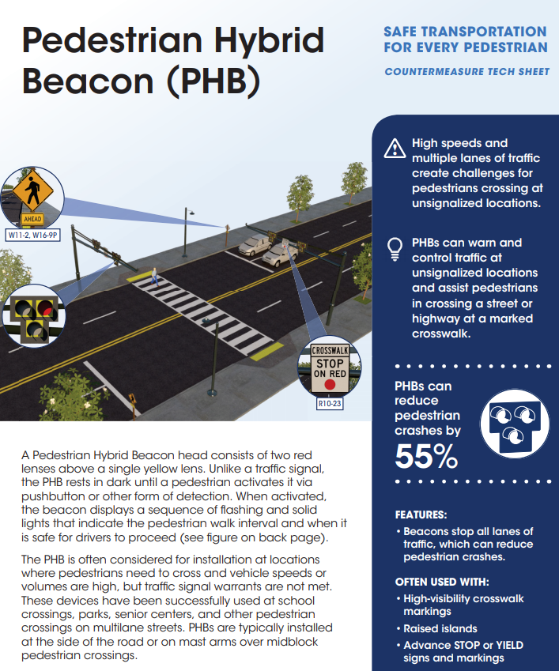
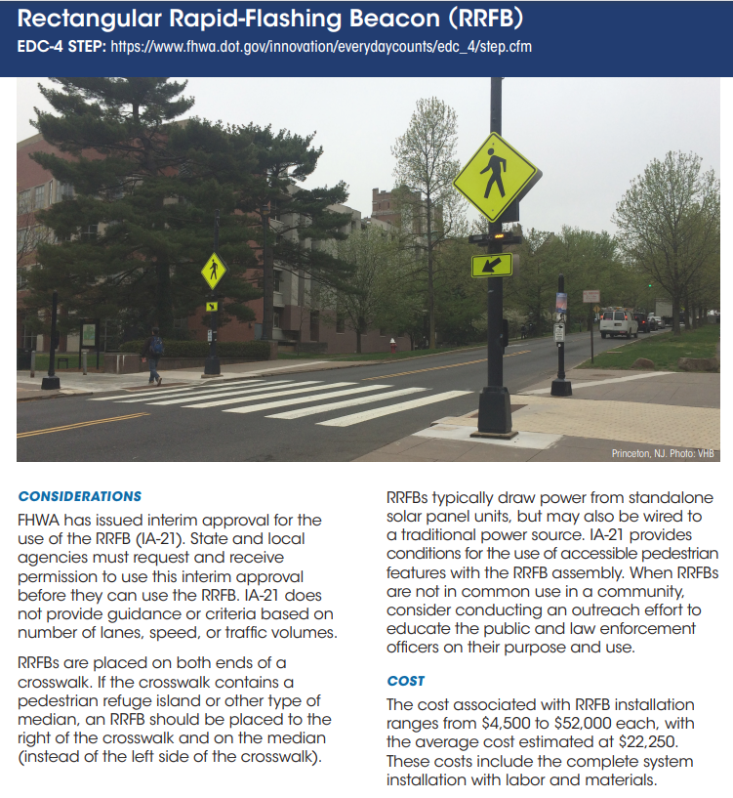
Tech Sheets
One for each STEP countermeasure:
PHBs.
RRFBs.
Crosswalk Visibility Enhancements.
Road Diets.
LPIs.
Raised Crosswalks.
Pedestrian Refuge Islands.

Slide 48
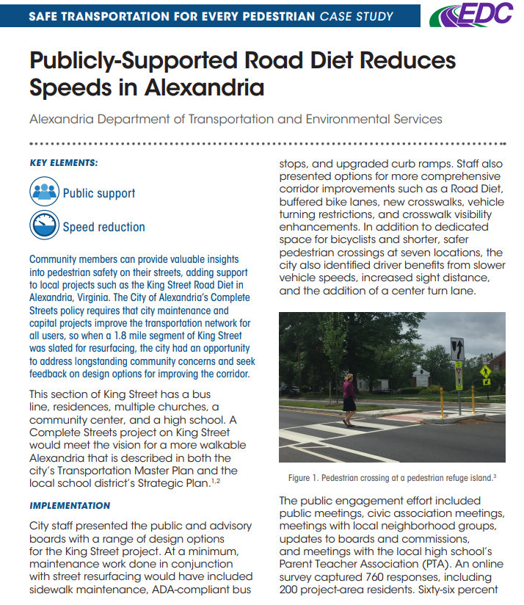
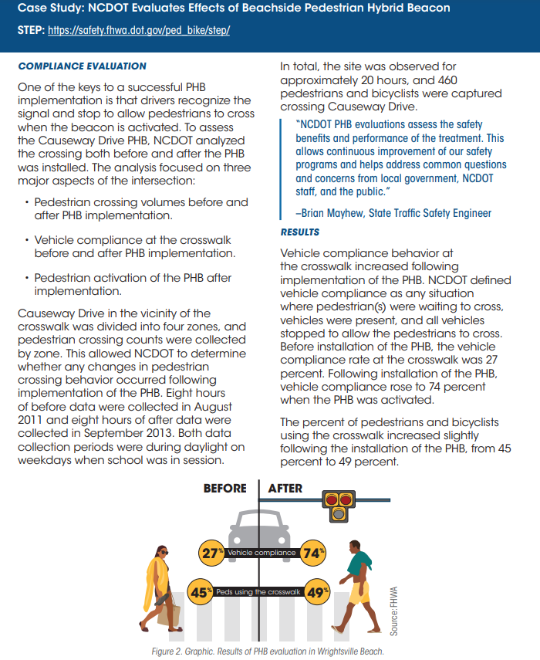
Case Studies
33 case studies from across the U.S. covering topics such as:
Countermeasure examples
Data analysis
Pedestrian safety plans
Project evaluation

Slide 49
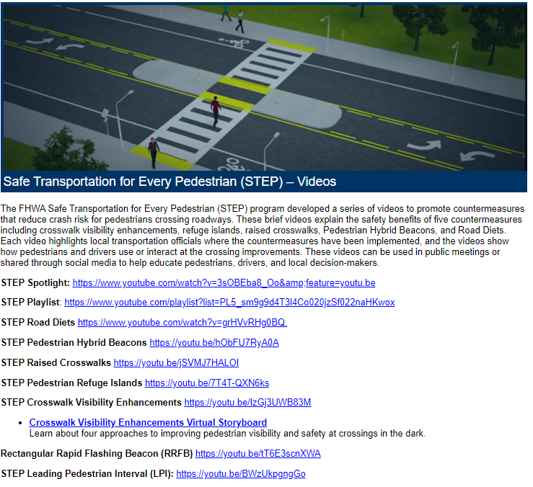
Videos
https://www.youtube.com/playlist?list=PL5_sm9g9d4T3l4Co020jzSf022naHKwox

Slide 50
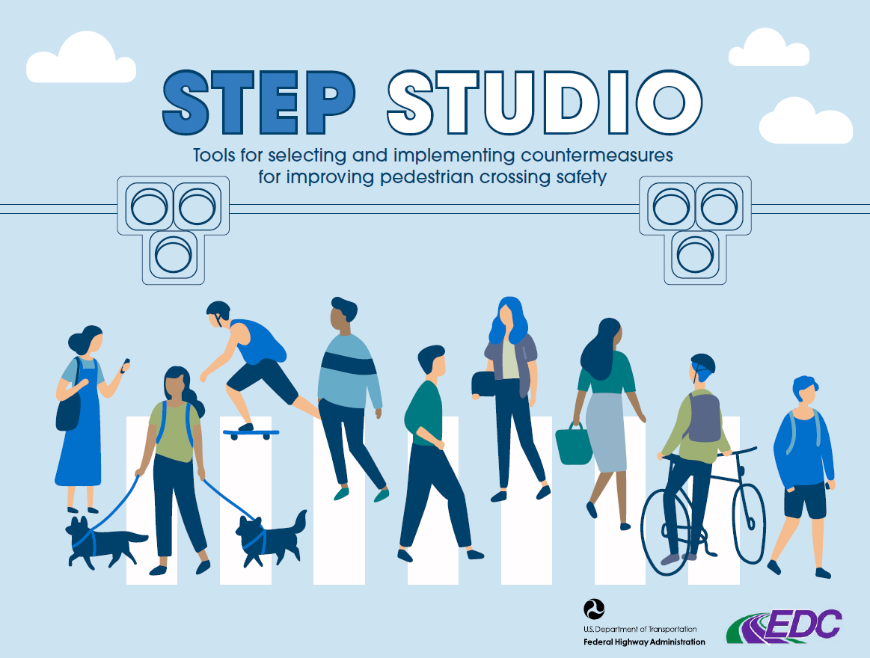
STEP Studio

Slide 51
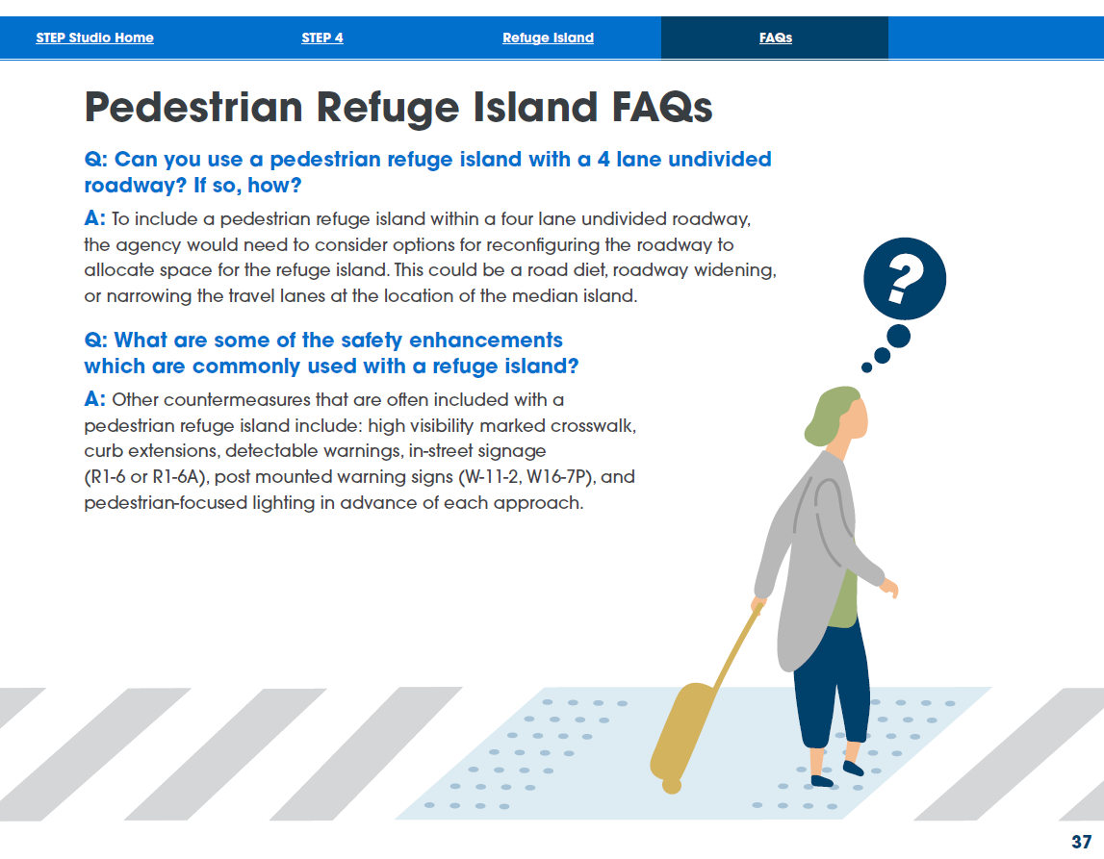
STEP Studio

Slide 52
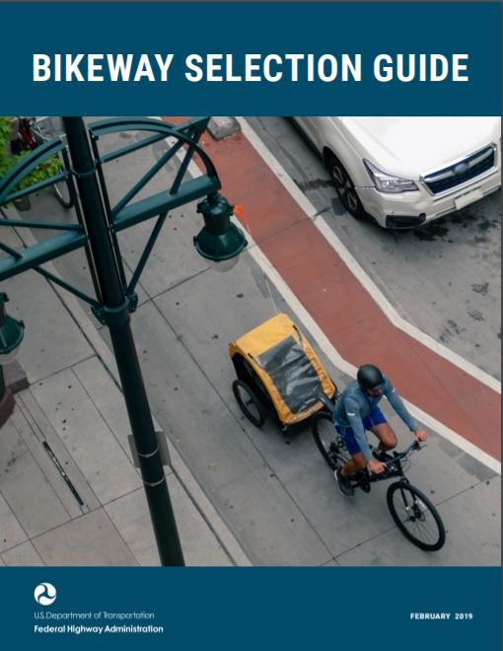
Bikeway Selection Guide
Helps transportation practitioners consider and make informed decisions about trade-offs relating to the selection of bikeway types.
Builds upon FHWA’s active support for design flexibility and connected, safe, and comfortable bicycle networks.
Based on the complementary Literature Review: Resource Guide for Separating Bicyclists from Traffic.
Technical Assistance available
Notes:
The Bikeway Selection Guide—a resource to help transportation practitioners consider and make informed decisions about trade-offs relating to the selection of bikeway types. It incorporates
and builds upon FHWA’s active support for design flexibility and connected, safe, and
comfortable bicycle networks.
The Guide is also based on the complementary Literature Review: Resource Guide for
Separating Bicyclists from Traffic. The literature review summarizes safety research for
common bikeway types and provides a brief history U.S. and international guidance for
bikeway selection.
The Guide references existing national resources and outlines a process for balancing
trade-offs by identifying the desired bikeway type, assessing and refining potential options, and evaluating feasibility. This process is intended to accelerate the delivery of high-quality multimodal projects that improve safety for everyone and meet the transportation needs of people of all ages and abilities.
This guide presents the bikeway selection process in a practical way. It provides detailed information about the key steps in the process, including:
-Establishing policies.
-Planning for connected, safe, and comfortable bicycle networks.
-Identifying projects and determining the
purpose.
-Identifying the desired bikeway type.
-Assessing and refining the bikeway type.
-Evaluating feasibility.
-Selecting the preferred bikeway type.
-Establishing a parallel route if necessary.

Slide 53
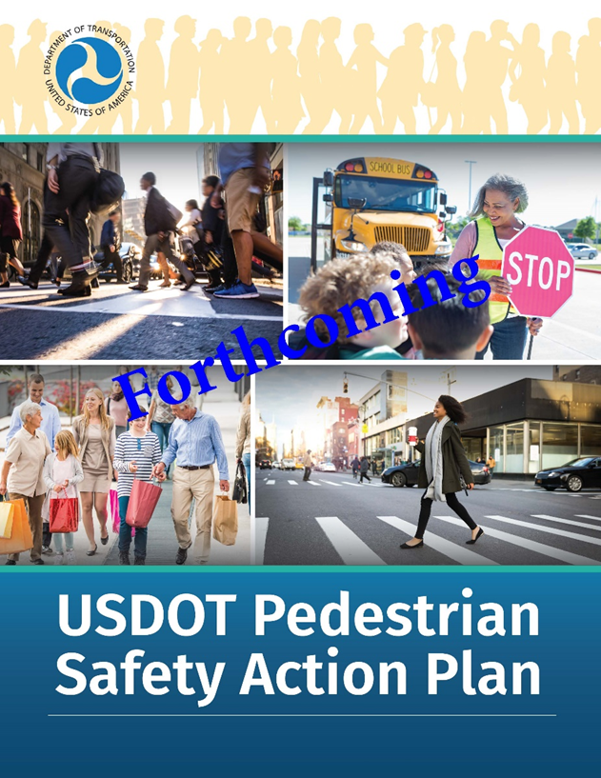
Forthcoming –
USDOT Pedestrian
Safety Action Plan
The Plan identifies what the USDOT intends to accomplish with respect to pedestrian safety in the next 2 years and beyond.

Slide 54

THANK YOU!

Slide 55
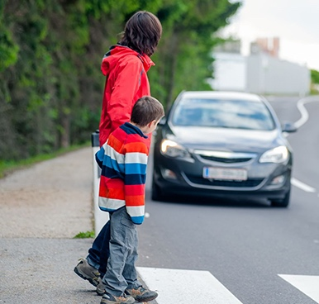
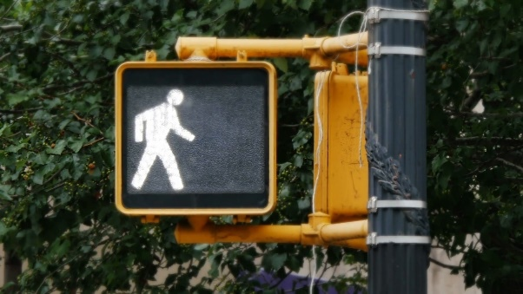


AASHTO TZD – Spotlight on Safety Webinar
ODOT’s Pedestrian Safety Improvement Program
AASHTO TZD Spotlight on Safety
Notes:
Good Afternoon!
Thank you for inviting Ohio to be a part of this STEP Scan Tour and we’re excited to be involved in the discussion of nationwide best-practices for pedestrian safety.

Slide 56


Agenda:
Pedestrian Safety Improvement Program
  Program Need
  Program Overview
AASHTO TZD Spotlight on Safety
Notes:
Today, we’re going to be covering our Pedestrian Safety Improvement Program, that I’ll frequently refer to as PSIP, which is being funded through the Highway Safety Improvement Program. The primary goal of PSIP was to use a fast-paced, streamlined approach in all parts of project development. Planning started in Summer of 2019 and construction is set to begin in the first quarter of calendar year 2021
Just as a quick outline, I will first be covering the Program’s need. I’ll share some important data points that helped us make some crucial decisions in PSIP’s infancy. Then, I’ll share how that data helped mold the selection processes. The first selection process was to determine which agencies would be able to participate in PSIP. Typically, funding granted through our HSIP is application-based, but this time we took a targeted approach and invited specific agencies to participate at no cost to them. The second selection process was to determine the sites that would be eligible for countermeasures, with which I’ll get into the ‘menu’ of countermeasures that were offered.
Last, I’ll briefly touch on the current state of PSIP and field any questions you may have about the program.

Slide 57



Program Need

Slide 58



Fatal Pedestrian Crashes
AASHTO TZD Spotlight on Safety
Notes:
Between 2009 – 2018 Ohio saw a 60% increase in the number of pedestrian related fatalities and a 15% increase in the number of serious injuries.
In 2019, we saw 120 pedestrian fatalities on Ohio’s roadways, but are expecting to see the highest in recent history in 2020.

Slide 59

Fatal Pedestrian Crashes
Through September
AASHTO TZD Spotlight on Safety
Notes:
And here is a snapshot of pedestrian fatalities and serious injuries in Ohio through the month of August over a 10-year period.
As you can see, 2020 is on pace to be the worst year in recent history by far for pedestrian safety. The pandemic seems to have had a negative effect on pedestrian safety nationwide, and it will be interesting to continue to analyze these trends and figure out some of the causations.
Also, as cities have made more attempts to be pedestrian-friendly, through OpenStreets-type initiatives, due to the pandemic, I’m curious to see if that sticks as traffic shifts to the new normal.

Slide 60



Pedestrian Fatalities by County
Ten counties accounted for 63% of severe pedestrian crashes
…
AASHTO TZD Spotlight on Safety
Notes:
So, seeing the alarming trend of increased pedestrian fatalities, we shifted gears to focus in on where severe crashes were occurring within the state.
Between 2014 and 2018, ten counties accounted for 65% of all pedestrian fatalities. And as you might expect these ten counties include many of the major population centers within the state.

Slide 61

Pedestrian Fatalities and Serious Injuries by Maintenance Authority
AASHTO TZD Spotlight on Safety
Notes:
We also noticed that pedestrian fatal and serious injury crashes were very overrepresented on our locally-maintained roads, particularly in cities. Just under 70% of all of Ohio’s pedestrian fatalities and serious injuries occurred in cities.

Slide 62

Pedestrian Safety Improvement Program:
High-Risk Facilities
AASHTO TZD Spotlight on Safety

Slide 63
Pedestrian FSI Crashes by Classification
Pedestrian Safety Improvement Program:
High-Risk Facilities
4-lane arterials make up less than 5% of the network, but 35% of pedestrian FSI crashes
AASHTO TZD Spotlight on Safety
Notes:
The next factor we investigated was roadway classification. Taking this dive, we found that, although arterials only make up 7-8% of the state’s entire network, almost 55% of pedestrian fatalities and serious injuries occur on them. 4-lane arterials are particularly overrepresented.

Slide 64

Pedestrian Safety Improvement Program:
Arterial Roads: Top Fatal Crash Types
2
1
3
AASHTO TZD Spotlight on Safety

Slide 65

Arterial Roads: Top Fatal Crash Types
Midblock Crossings
MIDBLOCK – CROSS (33%):
The pedestrian walked or ran into the roadway and was struck by a vehicle.
High Speeds:
Typically along 35+ MPH facilities
Urban Context:
85% occurred in urban settings
70% on City-Maintained roads
1
AASHTO TZD Spotlight on Safety
Notes:
The most common pedestrian-involved fatal crash type we see is the mid block crossing. As expected, after looking at the data from the last few slides, the vast majority are occurring in urban settings within cities. We’d also like to note that a majority of these were occurring on higher speed (35 mph +) roads.

Slide 66

Arterial Roads: Top Fatal Crash Types
Through Vehicle at an Intersection
THROUGH VEHICLE AT INTERSECTION (21%)
The pedestrian was struck at a signalized or unsignalized
intersection by a vehicle that was traveling straight ahead.
Urban Context:
Majority occurred in urban areas
Un-marked Crosswalks:
Markings typically not present
2
Stop-Controlled:
Intersection typically un-signalized
AASHTO TZD Spotlight on Safety
Notes:
The next common fatal pedestrian crash type is getting struck by a through vehicle at an intersection. While this includes both marked and unmarked crossings, we’re seeing most of these happen where crossings are not marked and where there is not a signal present. Yet again, these are primarily happening in urban areas.

Slide 67

Arterial Roads: Top Fatal Crash Types
Walking Along the Roadway
Lack of Sidewalks:
70% along no sidewalk segments
Dark Conditions:
88% occurred at night
WALKING ALONG ROADWAY (17%):
The pedestrian was walking or running along the roadway and was struck from the front or from behind by a vehicle.
4-Lane Arterials:
Majority of crashes occurred on 4-lane Arterials
3
AASHTO TZD Spotlight on Safety
Notes:
The third most common pedestrian-involved fatal crash type we’ve seen is walking along the roadway. With this one the proportion of crashes happening in urban and rural contexts is more evenly split. The notable factors we see with these types of crashes is that most are occurring along 4-lane arterials, where there is no sidewalk, at night, with the presence of street lighting not playing a large factor.

Slide 68
Program Overview
Program Overview + Process

Slide 69

Pedestrian Safety Improvement Program:
Program Overview
PURPOSE:
  This program provides eligible high-risk jurisdictions funding & assistance to implement proven low-to-medium cost pedestrian safety countermeasures along high-risk facilities.
FUNDING:
  $10 Million in Construction ($750K – $2.5M per participant)
TIMELINE:
  Kicked-off in September 2019
AASHTO TZD Spotlight on Safety
Notes:
As a quick overview, the purpose of this program was to provide funding and technical assistance to implement low-to-medium cost pedestrian safety countermeasures to eligible jurisdictions along high risk facilities. We made $10M of construction funding available for this project and are spending about $1.3M additional using task order design assistance.
We invited eligible participants to be a part of this program last summer and officially kicked off last September.

Slide 70
Pedestrian Safety Improvement Program:
Eligible Participants
Pedestrian Crashes by Eligible Participant (2009-2018)
Jurisdiction | Fatal | Serious Injury | Minor Injury | Injury Possible | No Injury | Total | FSI | District
COLUMBUS | 150 | 631 | 2,187 | 1,068 | 412 | 4,448 | 781 | D6
CLEVELAND | 72 | 373 | 1,007 | 1,088 | 337 | 2,877 | 445 | D12
CINCINNATI | 51 | 498 | 1,345 | 980 | 243 | 3,117 | 549 | D8
TOLEDO | 48 | 290 | 495 | 430 | 88 | 1,351 | 338 | D2
DAYTON | 35 | 172 | 328 | 217 | 43 | 795 | 207 | D7
AKRON | 21 | 192 | 438 | 277 | 137 | 1,065 | 213 | D4
YOUNGSTOWN | 17 | 45 | 75 | 70 | 17 | 224 | 62 | D4
CANTON | 15 | 69 | 142 | 107 | 30 | 363 | 84 | D4
 | 409 | 2,270 | 6,017 | 4,237 | 1,307 | 14,240 | 2,679
AASHTO TZD Spotlight on Safety
Notes:
The eligible agencies were selected using crash data. We selected the 8 agencies in the state that see the largest share of pedestrian fatal and serious injury crashes. To no surprise, these are 8 of Ohio’s 9 largest cities.

Slide 71
Pedestrian Safety Improvement Program:
Eligible Participants
Allocations by Jurisdictions
Jurisdiction | Base Allocation | Need Allocation | Total Allocation
COLUMBUS | $500,000 | $2,000,000 | $2,500,000
CLEVELAND | $500,000 | $1,000,000 | $1,500,000
CINCINNATI | $500,000 | $900,000 | $1,400,000
TOLEDO | $500,000 | $800,000 | $1,300,000
DAYTON | $500,000 | $500,000 | $1,000,000
AKRON | $500,000 | $300,000 | $800,000
YOUNGSTOWN | $500,000 | $250,000 | $750,000
CANTON | $500,000 | $250,000 | $750,000
 | 4M | 6M | 10M
“Total Allocation”: Construction Authority to spend against
AASHTO TZD Spotlight on Safety
Notes:
We then moved to determine how much of the $10M each participant should get. We started with a base allocation of $500k to each city and dispersed the remaining $6M based on need. In this case, need was determined by comparing pedestrian fatalities in each of the participating cities.

Slide 72
Pedestrian Safety Improvement Program:
Location Selection
Location Selection:
  Cities were able to pick their own locations with limited criteria
    Must be on an arterial or collector
    ROW can not be purchased
AASHTO TZD Spotlight on Safety

Slide 73
Pedestrian Safety Improvement Program:
Process Overview
Jurisdiction X
LEGEND:
High Risk Segment:
Low Risk Segment:
County Boundary:
Potential treatment location:
AASHTO TZD Spotlight on Safety

Slide 74
Pedestrian Safety Improvement Program:
Process Overview
Jurisdiction X
LEGEND:
High Risk Segment:
Low Risk Segment:
County Boundary:
Potential treatment location:
AASHTO TZD Spotlight on Safety

Slide 75



Pedestrian Safety Improvement Program:
Process Overview
COUNTERMEASURE BUNDLE:
Jurisdiction X
Leading Ped Intervals &
Increased crossing times
LEGEND:
High Risk Network:
Low Risk Segment:
County Boundary:
High-Visibility Crosswalk Markings
Potential treatment location:
AASHTO TZD Spotlight on Safety

Slide 76


Pedestrian Safety Improvement Program:
Countermeasure Selection
Eligible Countermeasures:
  Roadway Geometry:
    Curb Ramps w/ Detectable Warnings
    Raised Crosswalks*
    Curb Extensions
    Pedestrian Refuge Islands*
    Reduced Curb Radii
  Signalization:
    Pedestrian Hybrid Beacons*
    Accessible Pedestrian Signals
    Pedestrian Countdown Signals
  Other Elements:
    Street Lighting
*One of the 7 STEP-recommended countermeasures
AASHTO TZD Spotlight on Safety

Slide 77


Pedestrian Safety Improvement Program:
Countermeasure Selection
Eligible Countermeasures (Cont.):
  Pavement Markings*:
    High-Visibility Crosswalk Markings
    Advanced Yield Markings
  Signage*:
    Standard Crosswalk Signage
    Overhead Signage
    Rectangular Rapid Flashing Beacons
*One of the 7 STEP-recommended countermeasures
Pedestrian Safety Improvement Program
AASHTO TZD Spotlight on Safety

Slide 78
Pedestrian Safety Improvement Program:
Location & Countermeasure Selection
Location & Countermeasure Selection:
  We provided a spreadsheet to each city to track locations and countermeasures that calculated a preliminary estimate
  Once completed, our task order consultant conducted a field review to determine:
    Countermeasures were appropriate for each location
    A more detailed estimate so we could move into design with a set list of locations and countermeasures
AASHTO TZD Spotlight on Safety

Slide 79
Pedestrian Safety Improvement Program:
Process Overview
PLANNING
(PL)
PRELIMINARY ENGINEERING (PE)
ENVIRONMENTAL ENGINEERING (EE)
FINAL ENGINEERING (FE)
CONSTRUCTION (CO)
Local Location & Countermeasure Identification
Task Order Design Contract
ODOT managed
AASHTO TZD Spotlight on Safety

Slide 80

Pedestrian Safety Improvement Program:
Process Overview
LOCATION SELECTION PROCESS - RESULTS:
  455 Individual Locations
  Over 2000 treatments
AASHTO TZD Spotlight on Safety
Notes:
Pending no major changes, we’re anticipating 455 locations across the eight cities to undergo construction for over 2000 unique treatments over the next year

Slide 81
?
Michelle May
Highway Safety Program Manager
ODOT Office of Program Management
614.644.8309
Michelle.May@dot.ohio.gov
Jeremy Thompson
Traffic Safety Engineer
ODOT Office of Program Management
614.466.7045
Jeremy.Thompson@dot.ohio.gov
AASHTO TZD Spotlight on Safety

